Slide 1
ESD for 2030: The Future Depends on Us!
AASHE webinar
January 22, 2020
Dr. Kim Smith

Slide 2
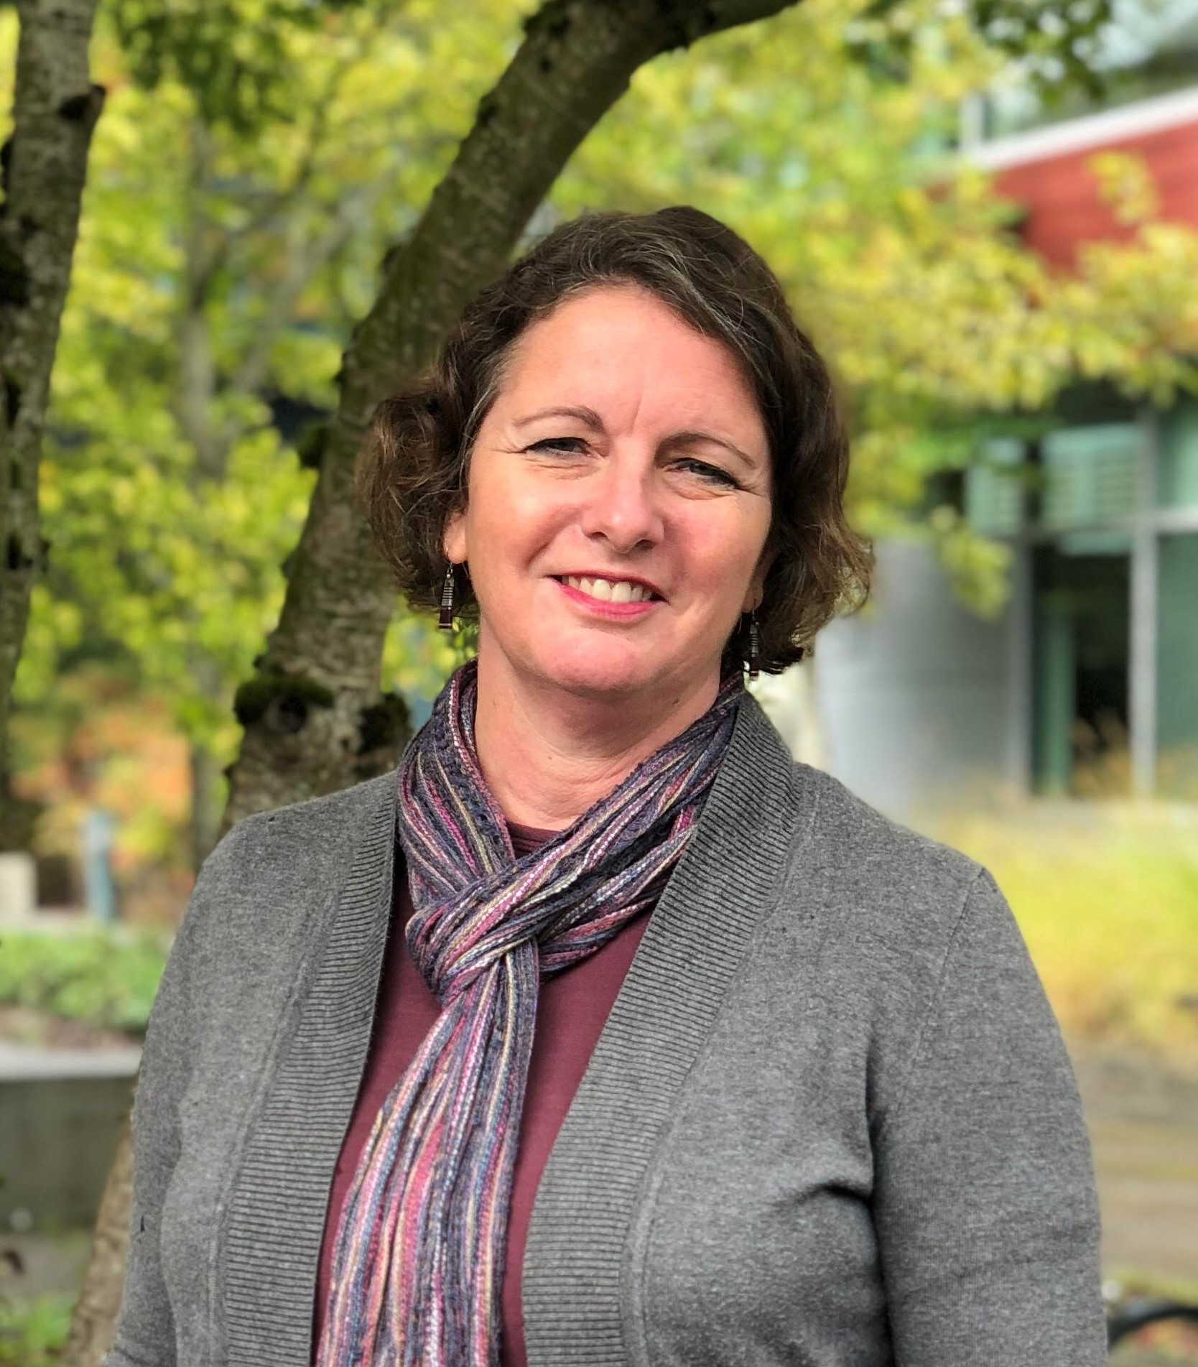
Kim Smith, Ph.D.
Portland Community College Sociology Instructor
RCE Greater Portland/GPSEN Co-Founder
AASHE International Liaison, Former Board Member
US Partnership for ESD International Fellow
SCC Advisory Council
Contact: kdsmith@pcc.edu

Slide 3

A New Decade – A New Opportunity

Slide 4

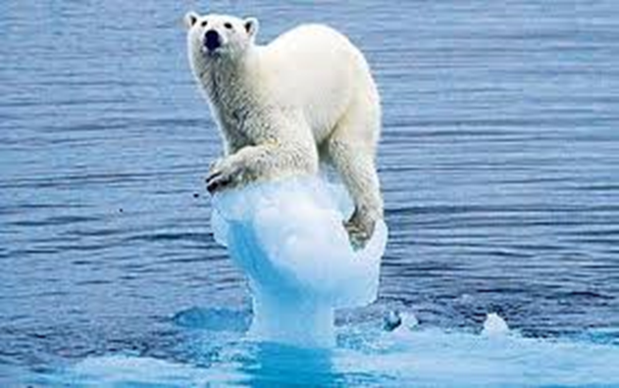
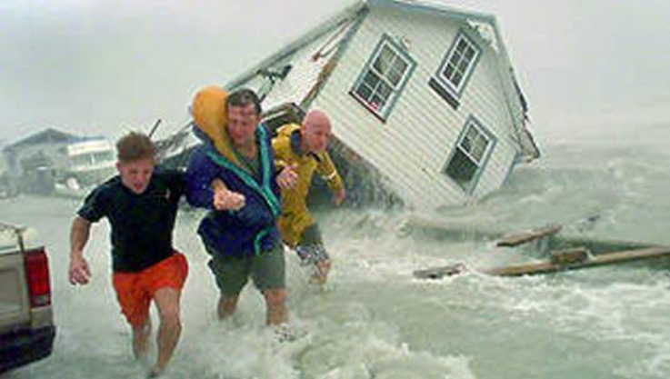
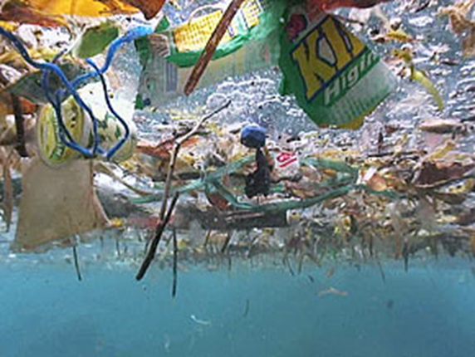
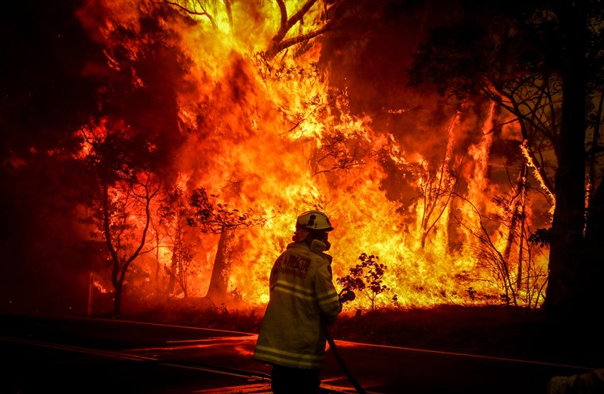
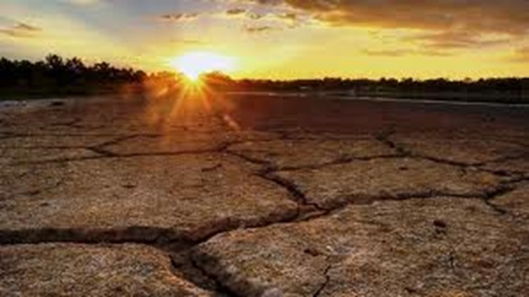
Why now?

Slide 5

Why ESD?
Education for Sustainable Development (ESD) equips learners with the knowledge, skills, values, and attitudes needed to contribute to a more inclusive, just, peaceful, and sustainable world.
Emphasize the need for education in all forms:
formal (schools and higher education)
non-formal (government and non-profit workshops; workforce training)
informal education (media and public awareness campaigns)

Slide 6
“A Framework For ESD Beyond 2019”
Where have we been?
How can we make a difference?
What’s next?

Slide 7



Earth Summit (Rio, 1992)
Ch. 36, Agenda 21

Slide 8


(Rio de Janeiro, 2012)

Slide 9
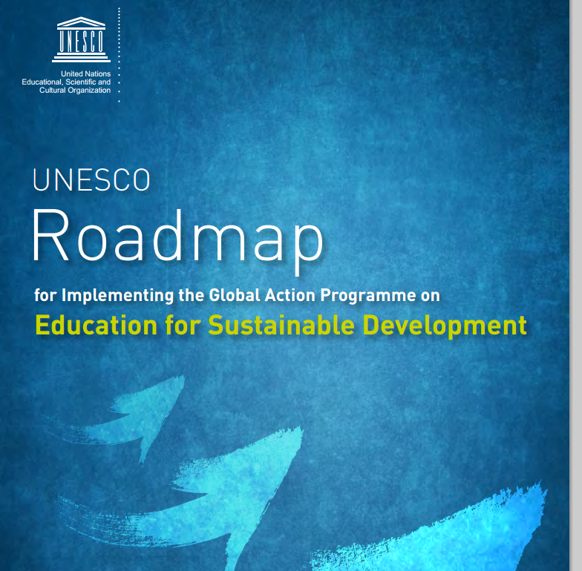
UNESCO World Summit on ESD (2014)
Global Action Programme on ESD (2015-2019)

Slide 10

Aspirational, with unprecedented scope and significance
Accepted by all countries, in September 2015
17 universal goals, 169 targets, and 244 indicators
Balances the three dimensions of sustainable development: social, economic, and environmental
Relevant to all developing and developed countries

Slide 11

Agenda 2030 (2015)

Slide 12
SDG 4.7: Education for Sustainable Development (ESD)
Goal 4 - Ensure inclusive and equitable quality education and promote life-long learning opportunities for all.
Target 4.7 - By 2030, ensure all learners acquire knowledge and skills needed to promote sustainable development, including among others through education for sustainable development and sustainable lifestyles, human rights, gender equality, promotion of a culture of peace and non-violence, global citizenship, and appreciation of cultural diversity and of culture’s contribution to sustainable development.
Notes:
The 17 Sustainable Development Goals and 169 targets which we are announcing today demonstrate the scale and ambition of this new universal Agenda. They seek to build on the Millennium Development Goals and complete what these did not achieve.

Slide 13

“Ahmedabad Plan” (2016)
Recommendations for how education, training, and public awareness can help us meet all of the SDGs
http://www.ceeindia.org/esdg/

Slide 14


“Individuals must become sustainability change-makers. They require the knowledge, skills, values, and attitudes that empower them to contribute to sustainable development.” (2017)

Slide 15
Cross-cutting Key Competencies for Achieving the SDGs
Systems thinking
Anticipatory competency (evaluate multiple futures, consequences, and risks)
Normative competency (norms, values, and actions, in context of conflicts of interests)
Strategic competency (innovative actions)
Collaboration
Critical thinking
Self-awareness
Integrated problem-solving

Slide 16
Post-GAP (2020-2030): What’s Next?

Slide 17
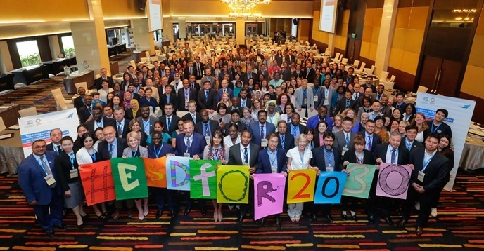
Consultation Meetings on the Future of ESD
116 UNESCO Member States and Associate Members (July 2018)

Slide 18
UNESCO launches new framework and UN decade! “Education for Sustainable Development: Towards achieving the SDGs” (ESD for 2030)
Overall goal: Build a more just and sustainable world through strengthening ESD and contributing to the achievement of the 17 SDGs and build education systems that support learners of all ages to be active contributors to more peaceful and sustainable societies (2020).
“Education is both a goal in itself and a means for attaining all the other SDGs. It is not only an integral part of sustainable development, but also a key enabler for it.”
~Qian Tang, Ph.D., Assistant Director-General for Education (2017)

Slide 19
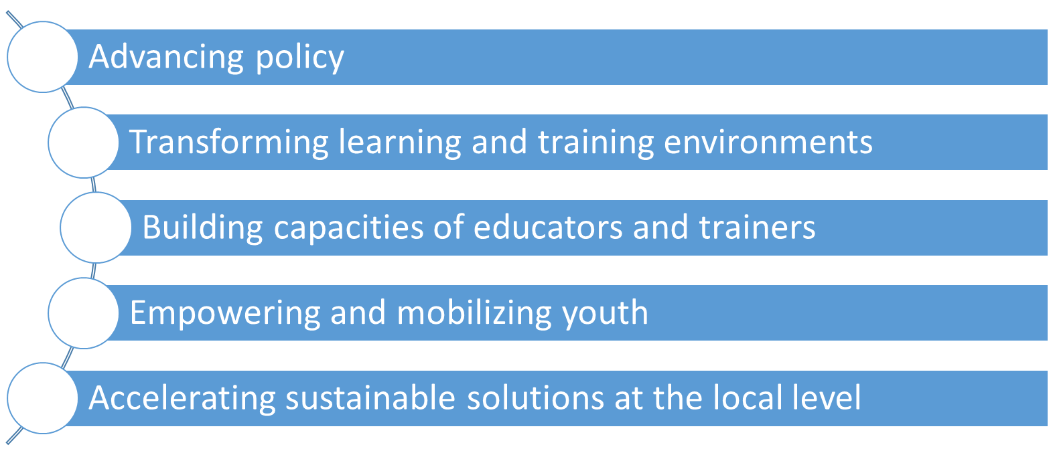
ESD for 2030 Priority Action Areas
1
2
3
4
5

Slide 20


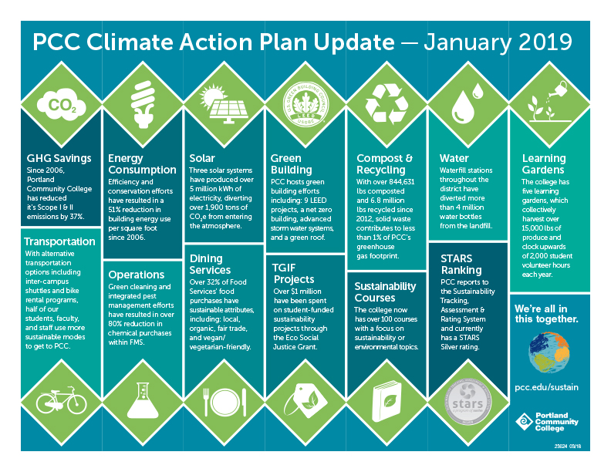






Advancing Policy: Missions and Strategic Plans
www.pcc.edu/sustain

Slide 21




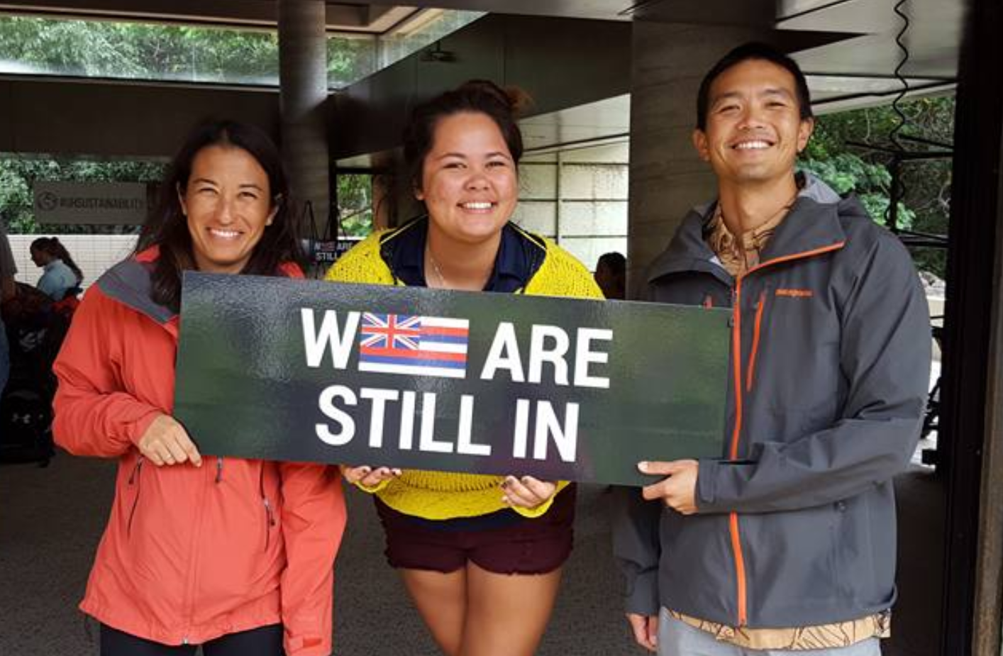





The Role of Civil Society: We Are Still In

Slide 22
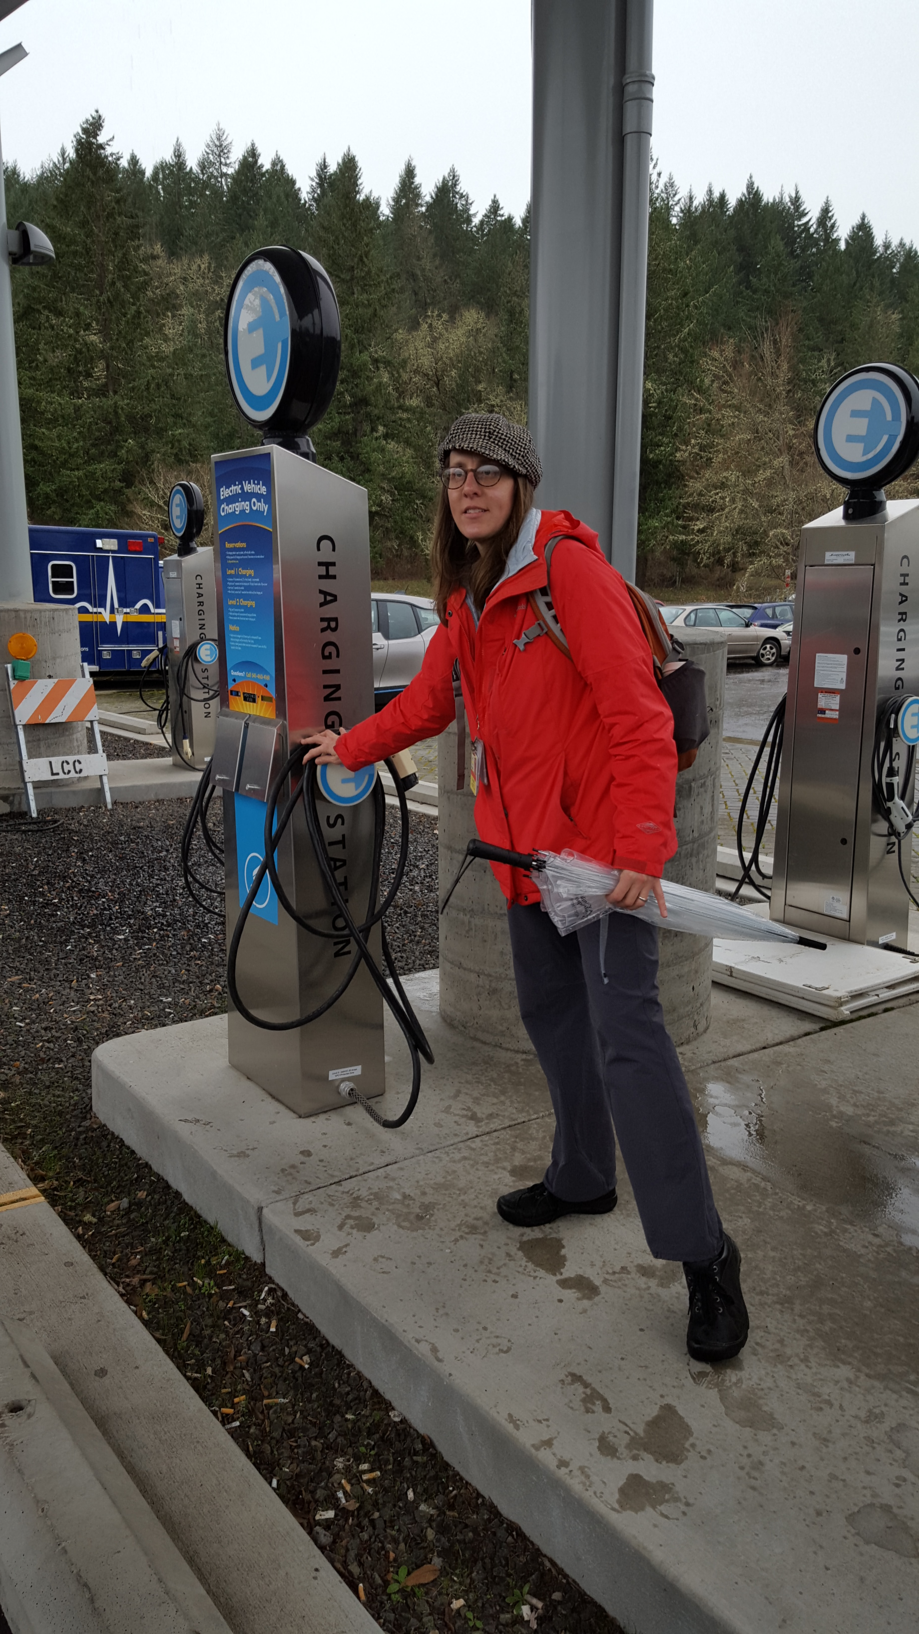
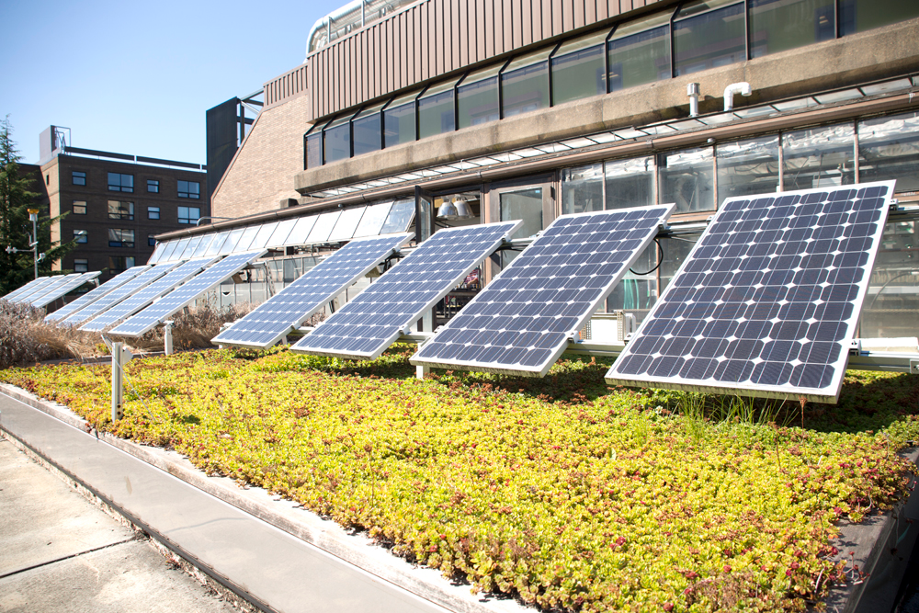
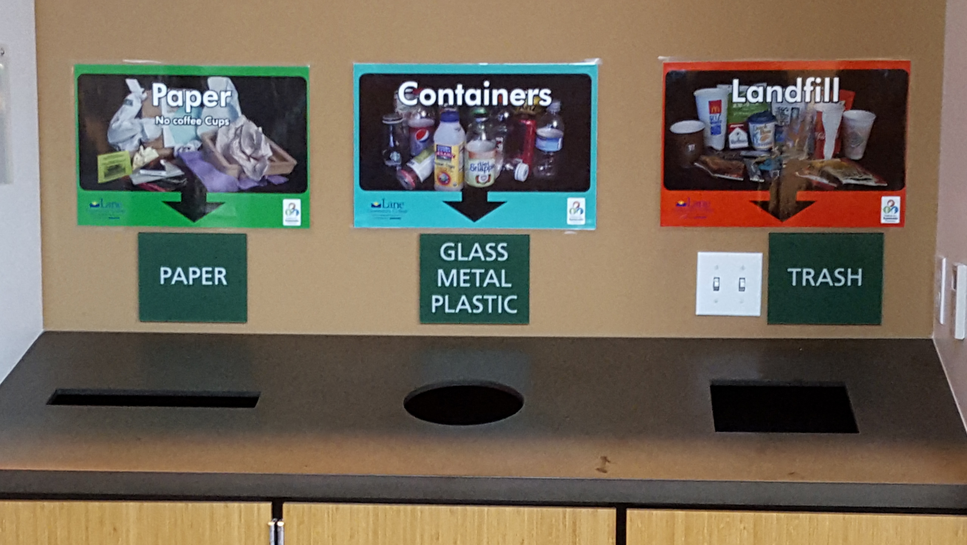
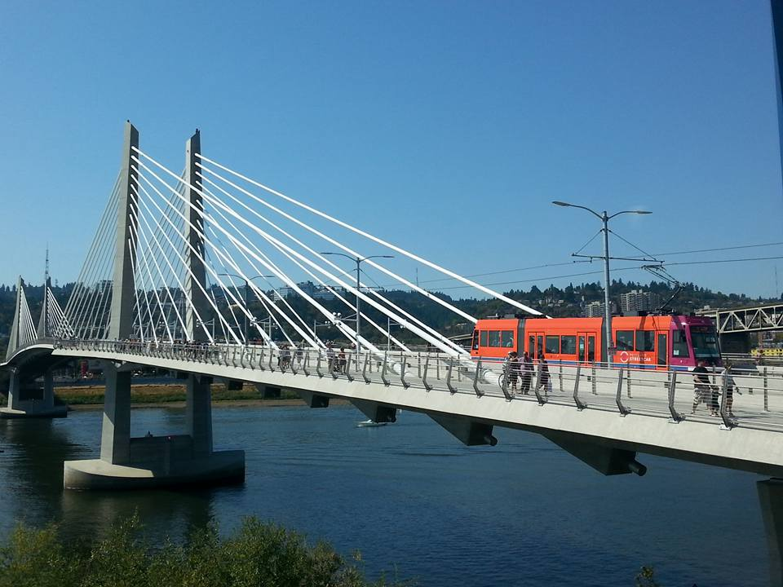
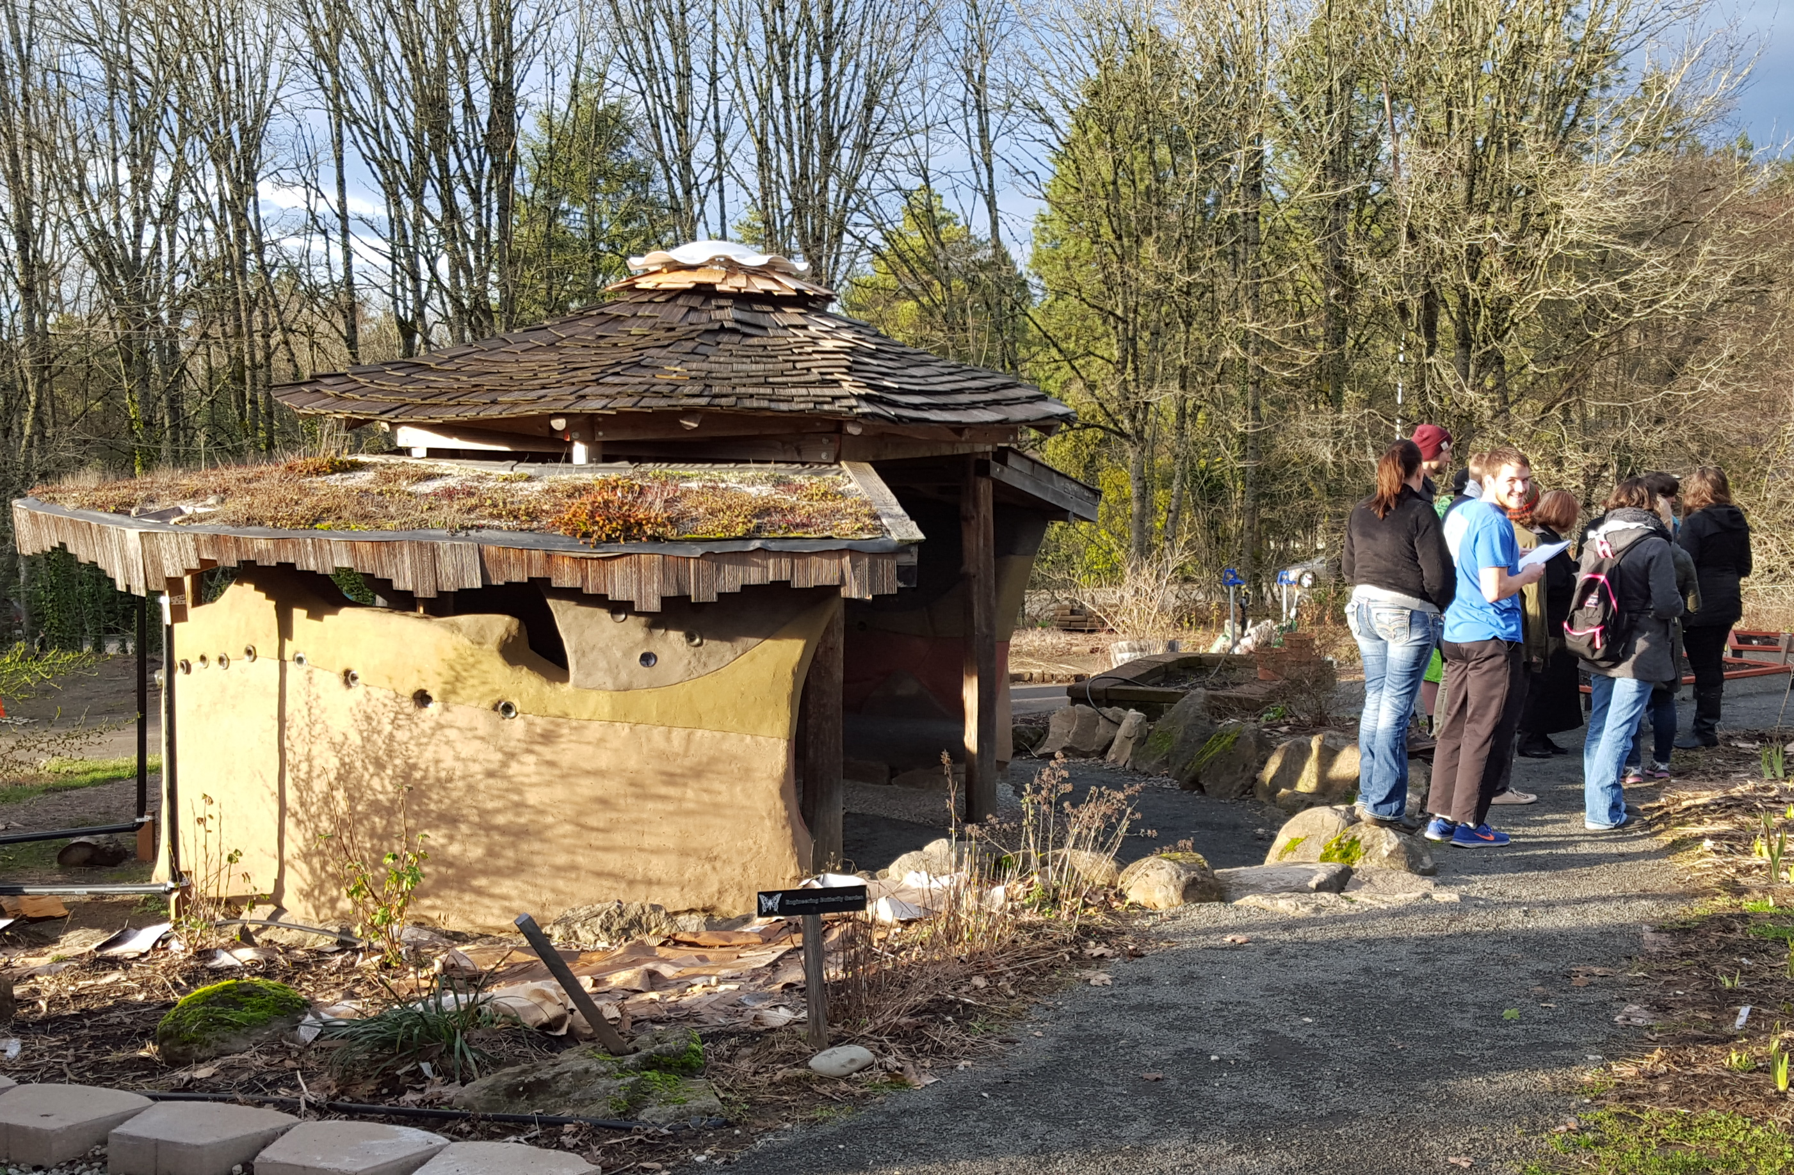
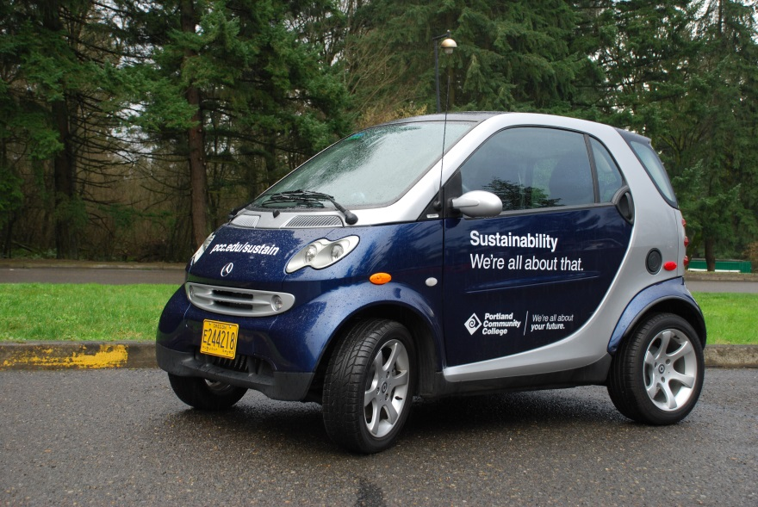
Transforming Learning and Training Environments
Operations
Green Construction
Energy Consumption
Purchasing
Waste Reduction
Transportation
Learning Gardens
Hiring Practices
Accreditation

Slide 23

Building Capacity of Educators and Trainers
Integrate ESD in policies, strategies, and programmes
Integrate ESD in curricula and textbooks
ESD in teacher education
Deliver ESD in the classroom and other learning settings
Whole-institution approaches
Action-oriented transformative pedagogy

Slide 24


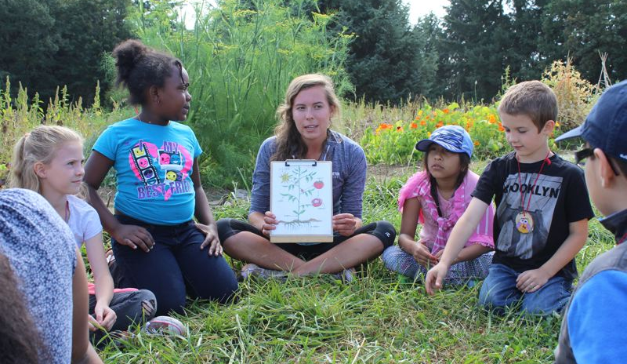


ESD in Curricula and Textbooks
Green Outcomes
Sustainability-Related Courses
Research Opportunities
Applied Learning Opportunities
Sustainability Degrees and Focus Awards

Slide 25

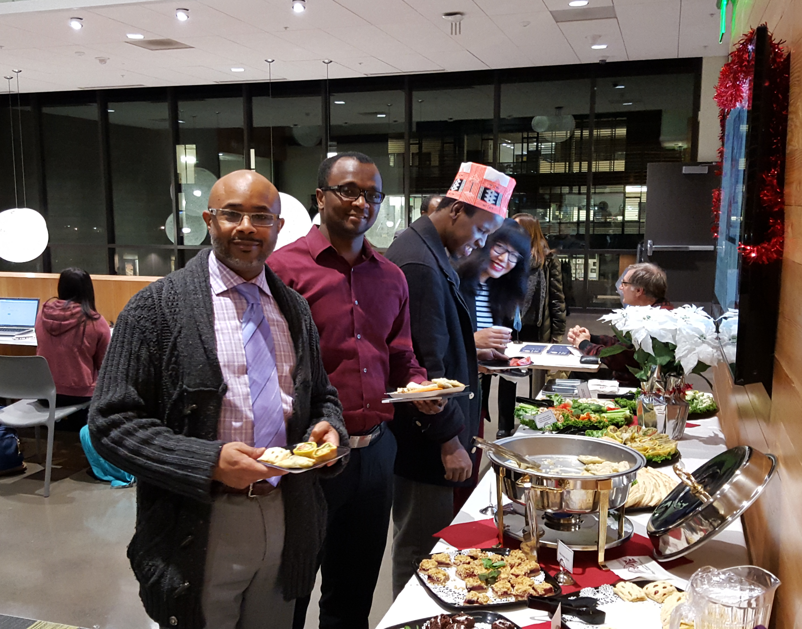
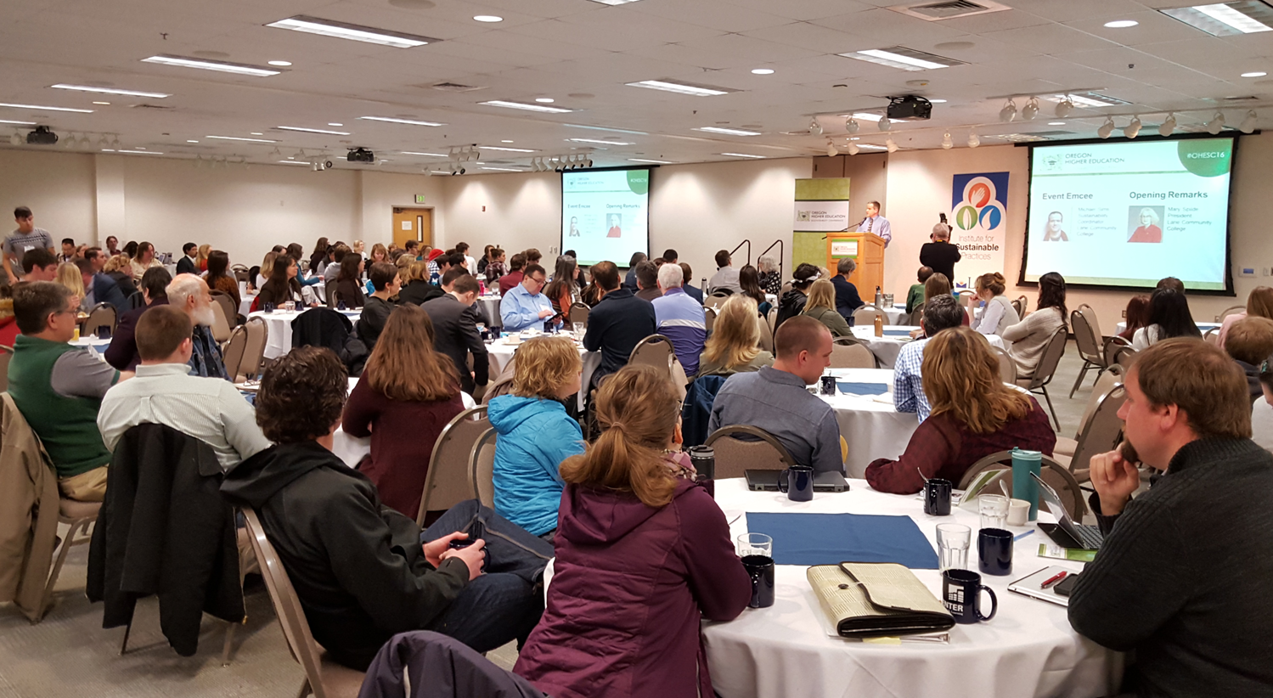

ESD in Teacher Education
Professional Development
Conferences
Webinars
Sustainability Curriculum Trainings
Green Certification
Resource Clearinghouses

Slide 26
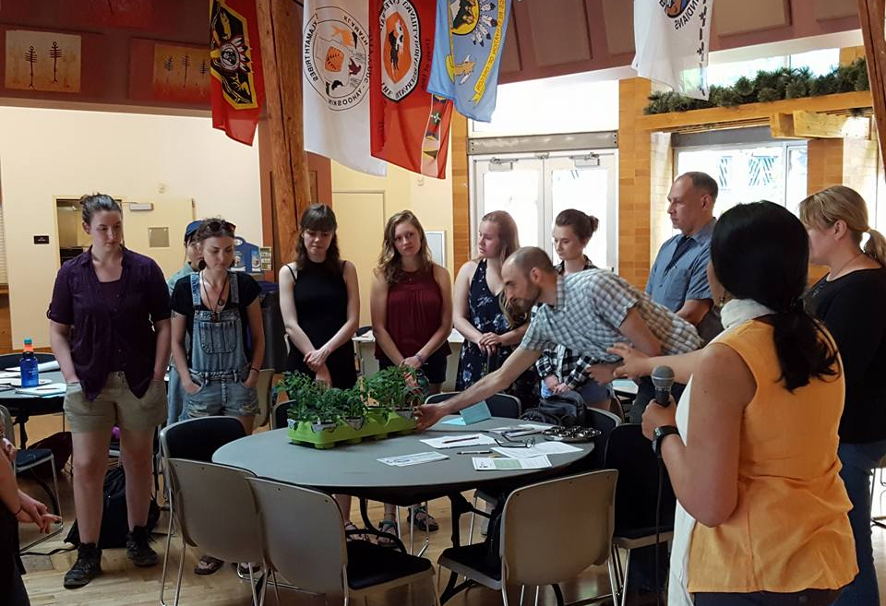

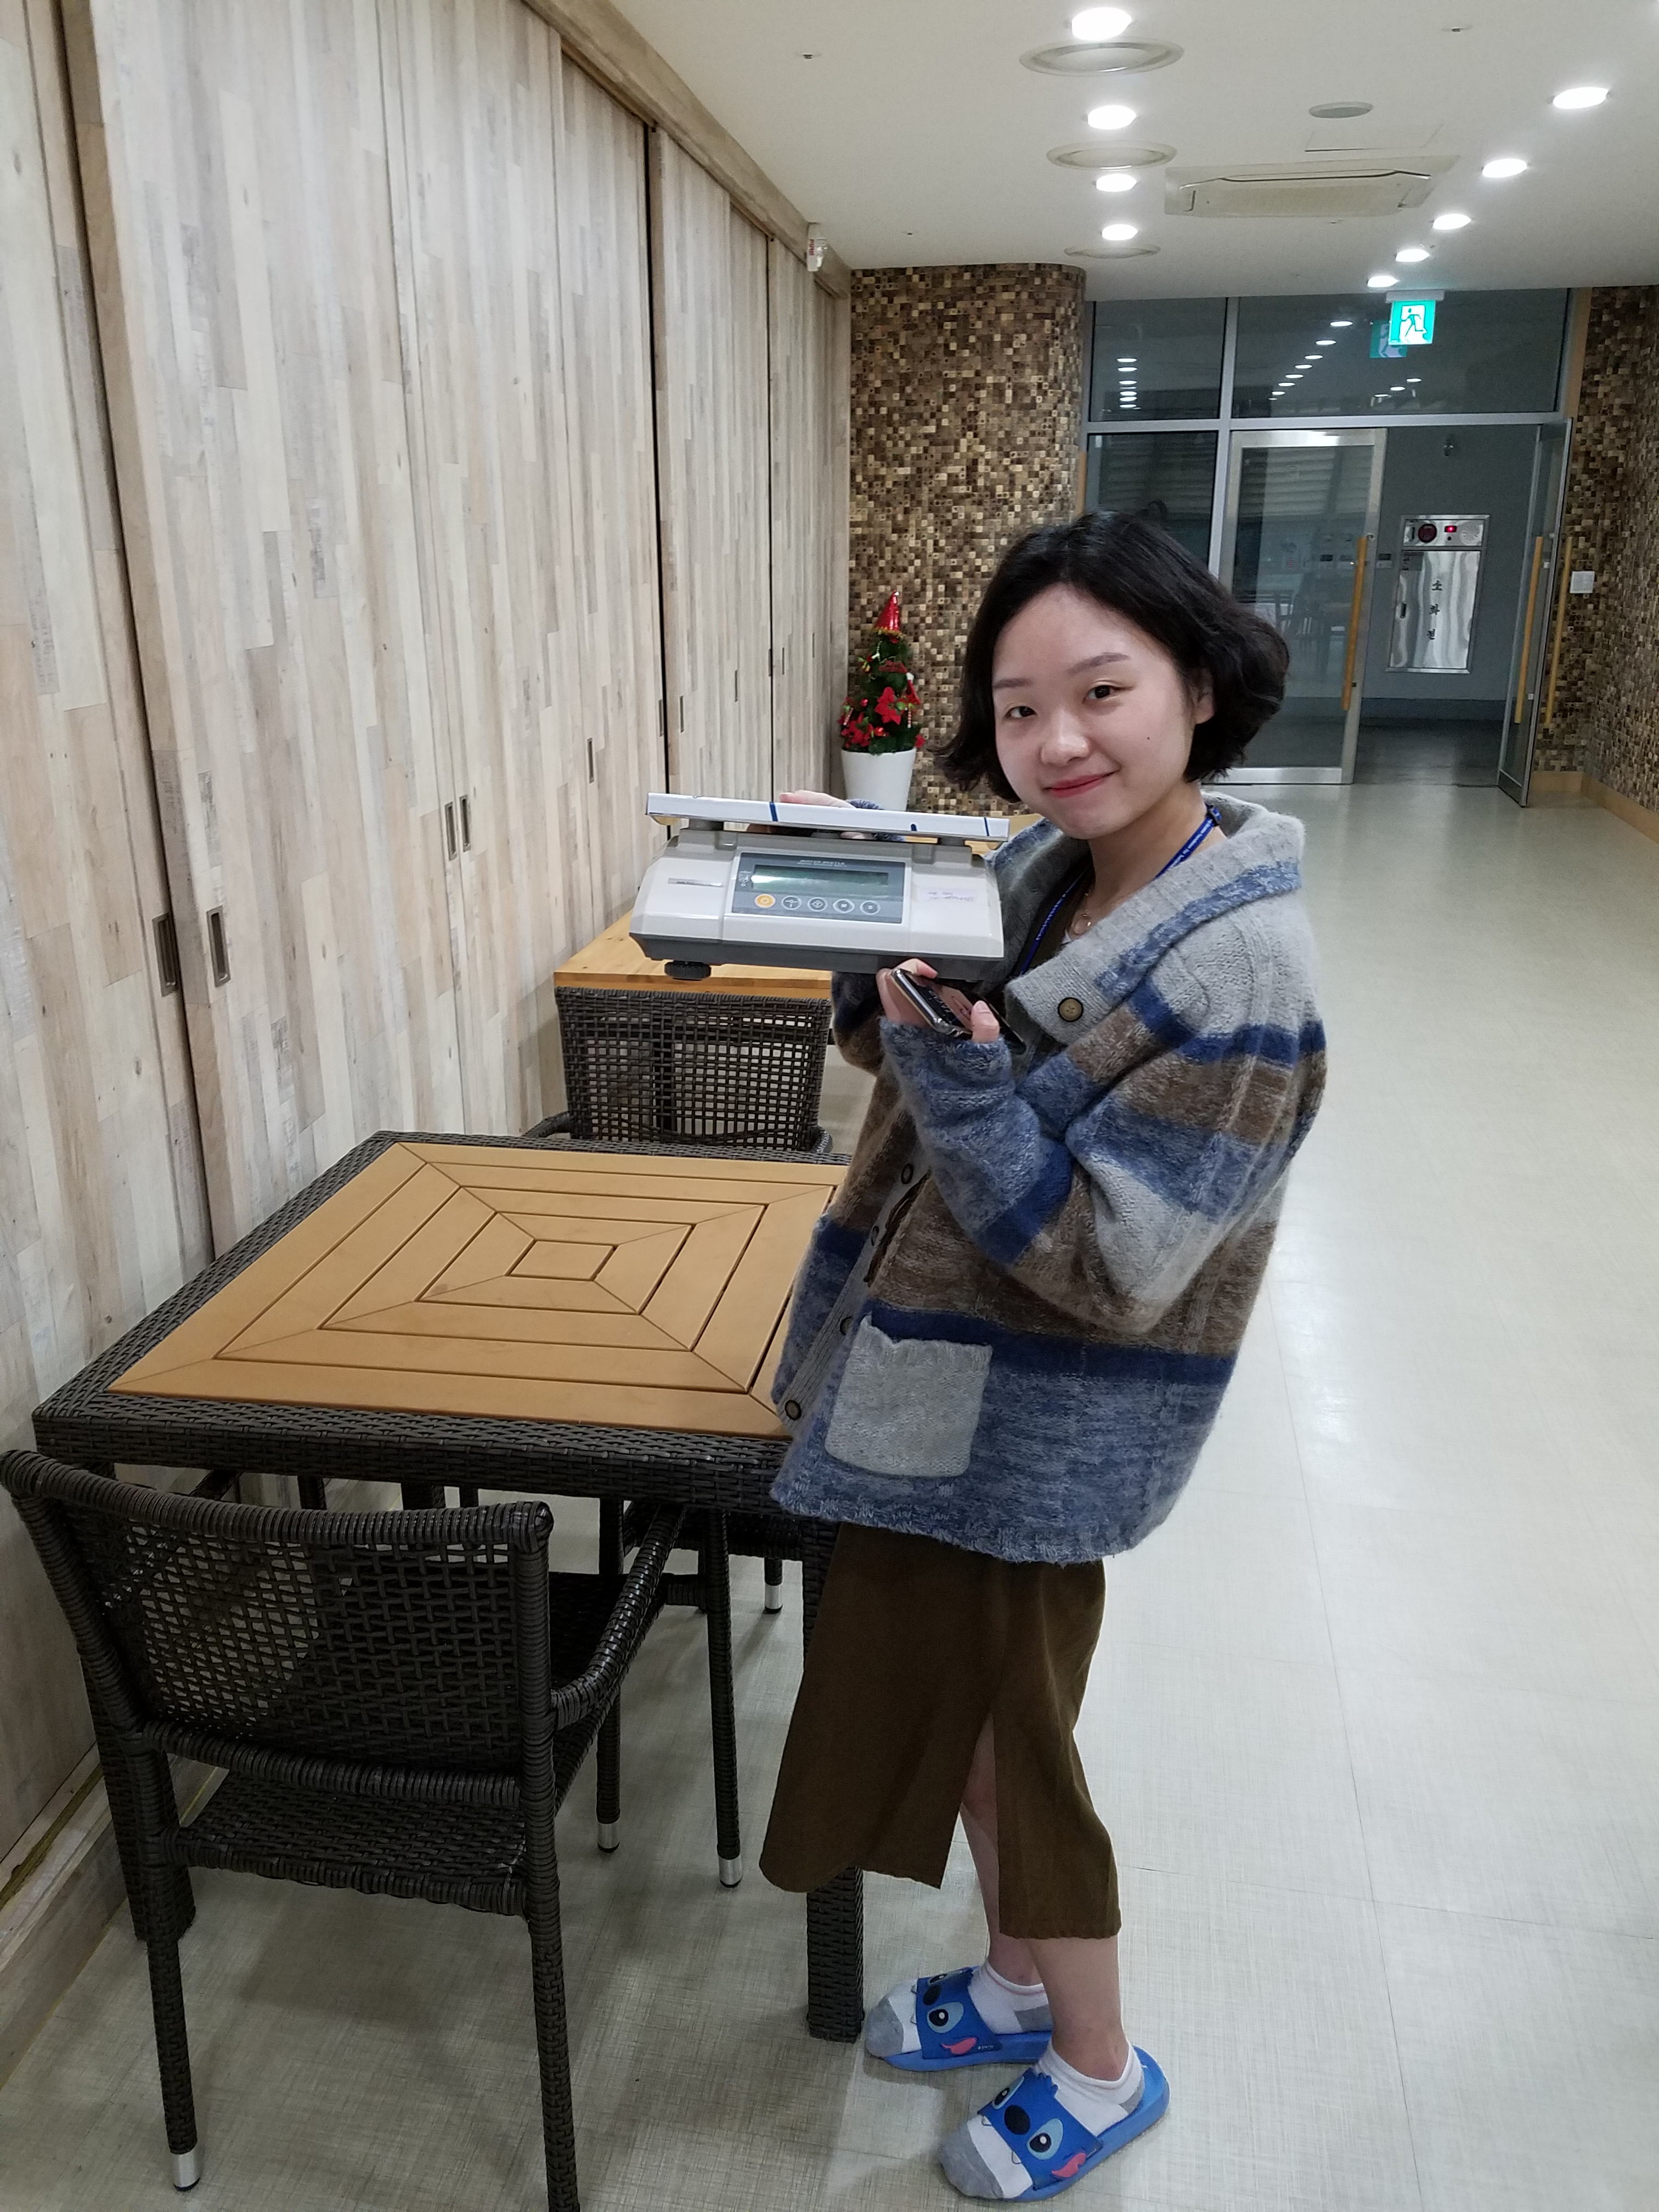
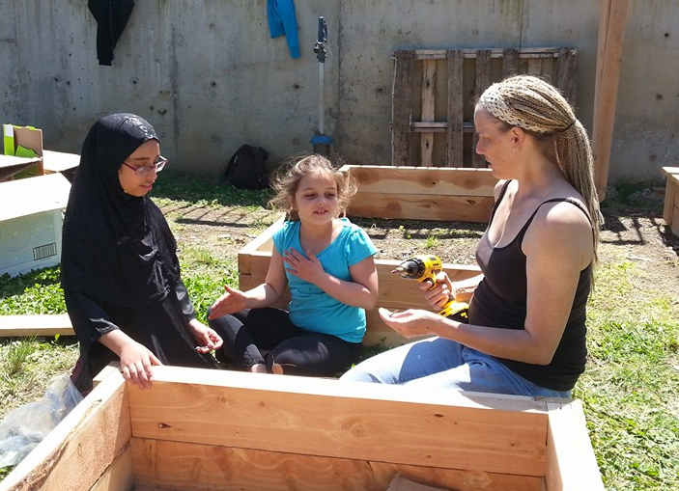

Empowering and Mobilizing Youth
College and Youth Networks
Green Initiative Funds
Train-the-Trainer Workshops
Course-Based Assignments
Service-Learning/CBL
Living Labs

Slide 27
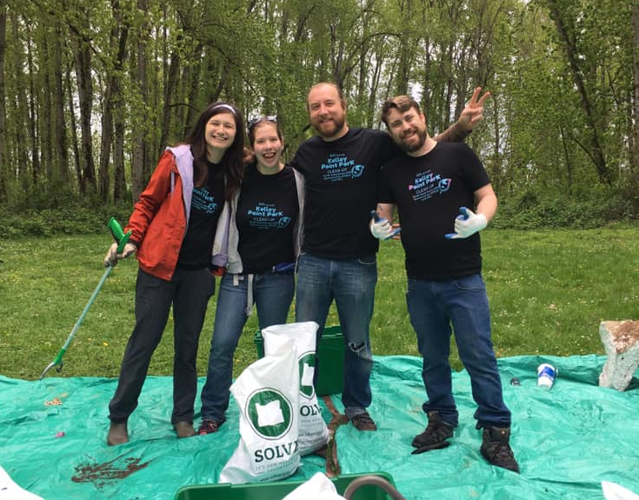
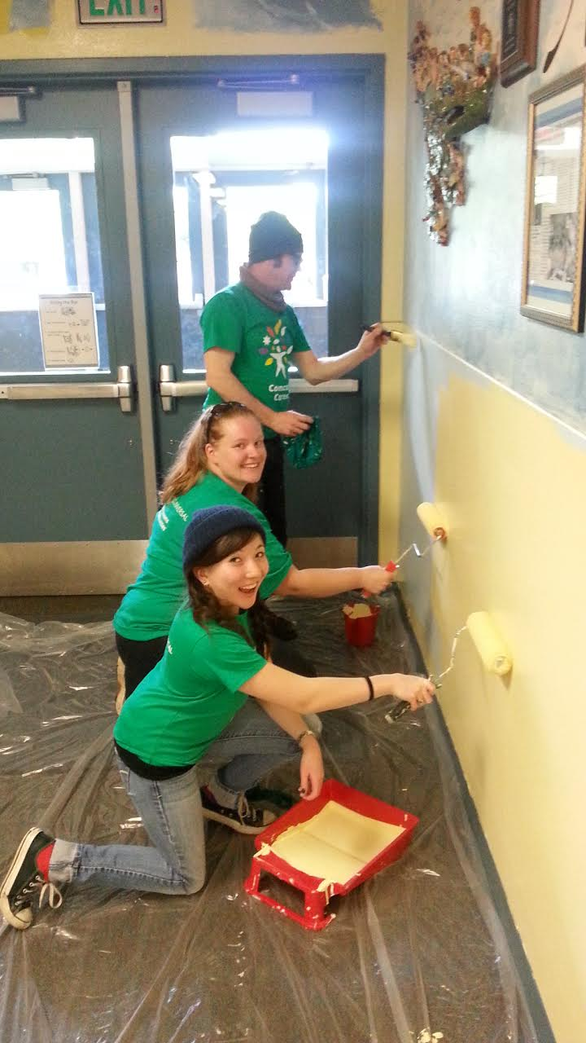
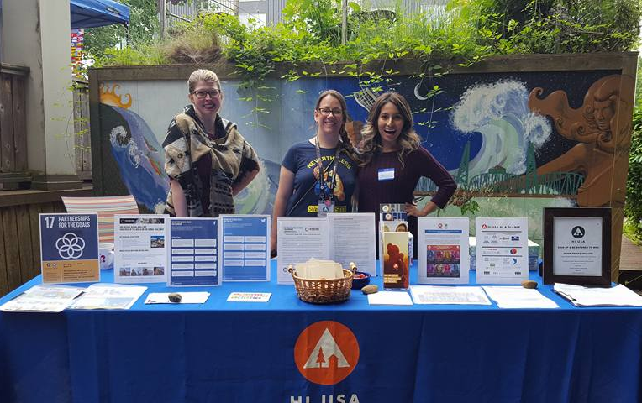
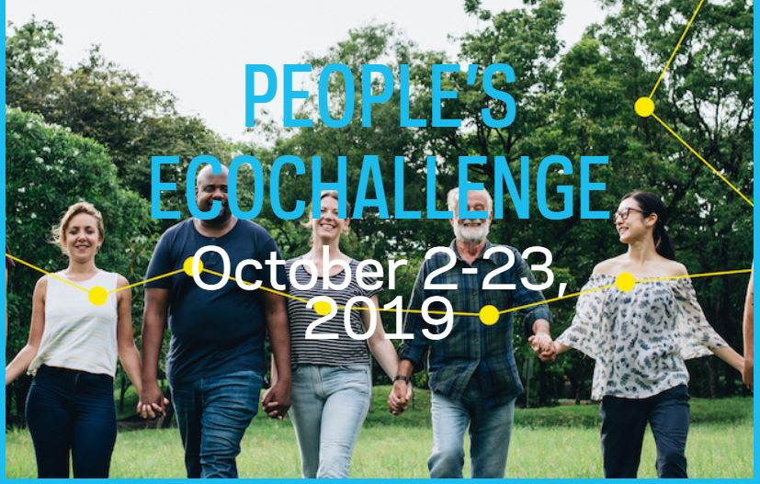
Accelerating Sustainable Solutions at the Local Level
Community-Based Learning
Civic Engagement
Community Partnerships

Slide 28
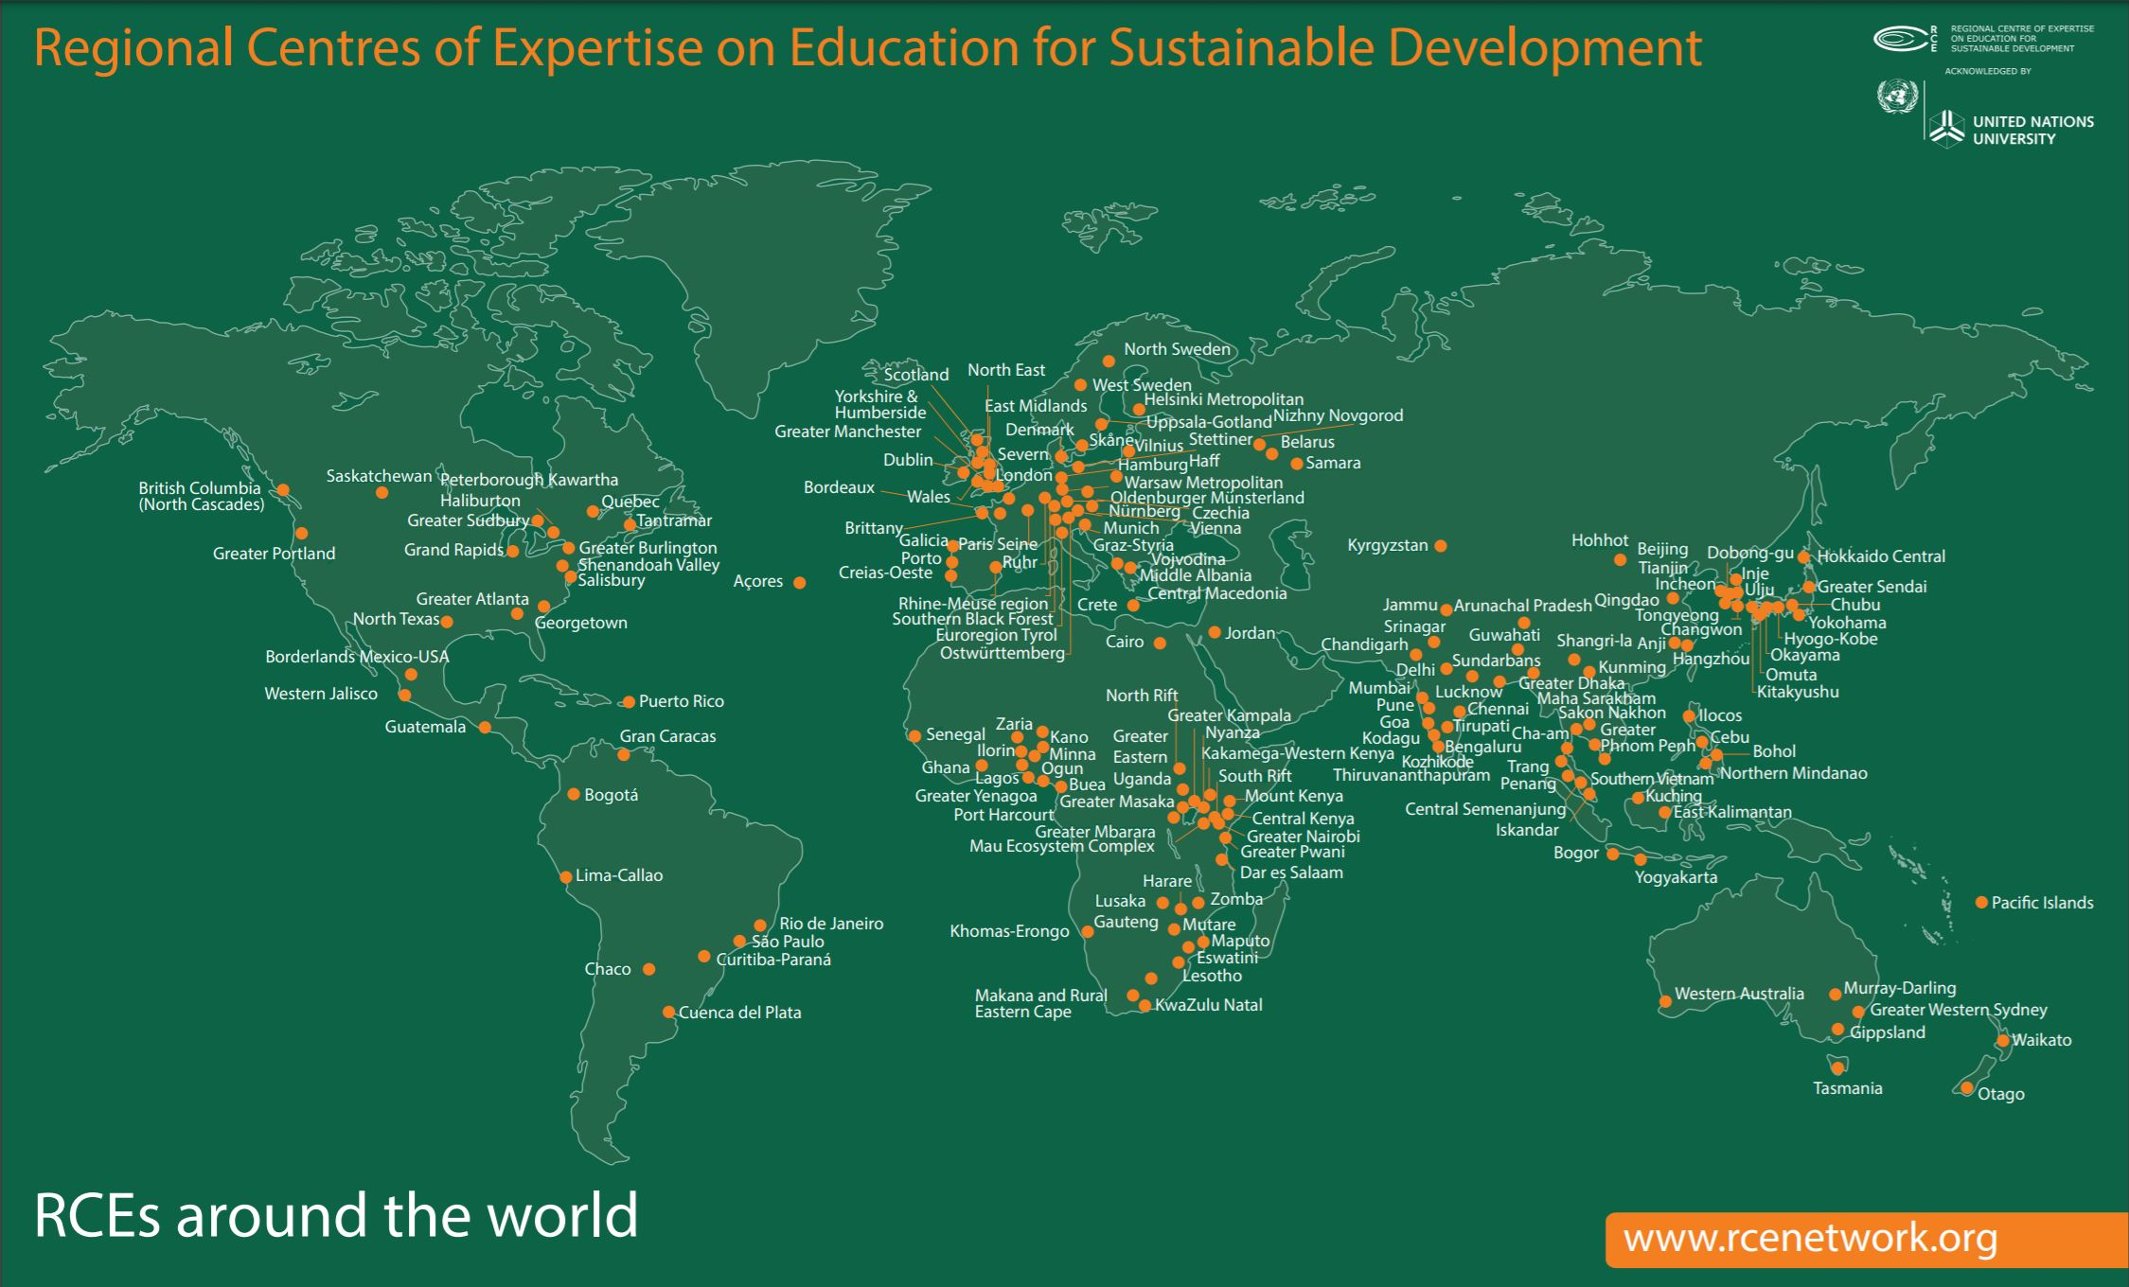

Slide 29

Recognized as an RCE in 2013
As an RCE, GPSEN connects diverse formal, non-formal, and informal organizations across sectors in a collaborative network to facilitate ESD and multiply our collective capacity to educate, empower, and engage for a sustainable future.

Slide 30
UNESCO World Conference in ESD Berlin, Germany, June 2-4, 2020
The Conference will:
raise public awareness of global challenges and ESD
highlight the crucial role of ESD as a key enabler for the successful achievement of all SDGs
create momentum for strengthening ESD in policy and practice
establish a strong basis for the ESD for 2030 Global Network

Slide 31
Conference Participants
800 participants from around the world: policy-makers, education practitioners, civil society, development community, and private sector experts.
All UNESCO Member States will be invited (participation by invitation only)
Note that the U.S. is no longer a Member, but we are still implementing ESD at regional levels and can apply to participate.
Call for proposals coming soon. For details: https://en.unesco.org/events/ESDfor2030

Slide 32
Final UNESCO Reflections on “ESD for 2030”
Transformative action
Necessitates disruption and courage
Global citizenship - ESD in action is citizenship in action
Structural changes
Need to focus on deep structural causes
Address issues of economic development and extreme poverty
The technological future
Prepare for shifts and tipping points
Work with key technology stakeholders

Slide 33
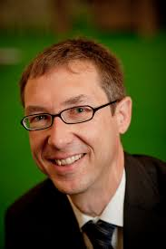
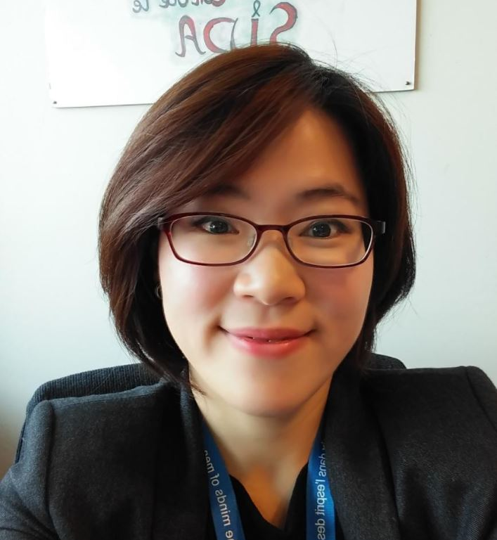
Thank you for the support from our UNESCO ESD leaders!
Alexander Leicht
Won Jung Byun
wj.byun@unesco.org
future.esd@unesco.org

Slide 34
For additional UNESCO information:
Visit: https://en.unesco.org/themes/education-sustainable-development
Sign up for ESD Zoom Newsletter: https://en.unesco.org/esd-newsletter

Slide 35

Thank you! Merci beaucoup!
Comments? Questions? Ideas?
Dr. Kim Smith
kdsmith@pcc.edu
www.gpsen.org
Educate ~ Empower ~ Engage

