Slide 1

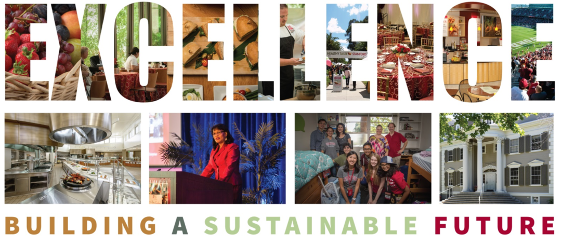
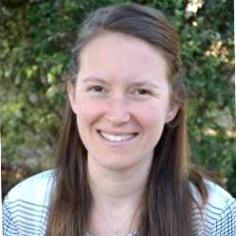

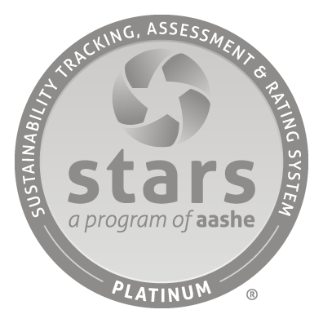
Stanford R&DE Student Housing Innovation in Green Cleaning
Transforming The Way We Clean
Kristin Parineh
Sustainability and Utilities Manager
kparineh@stanford.edu
Residential & Dining Enterprises

Slide 2

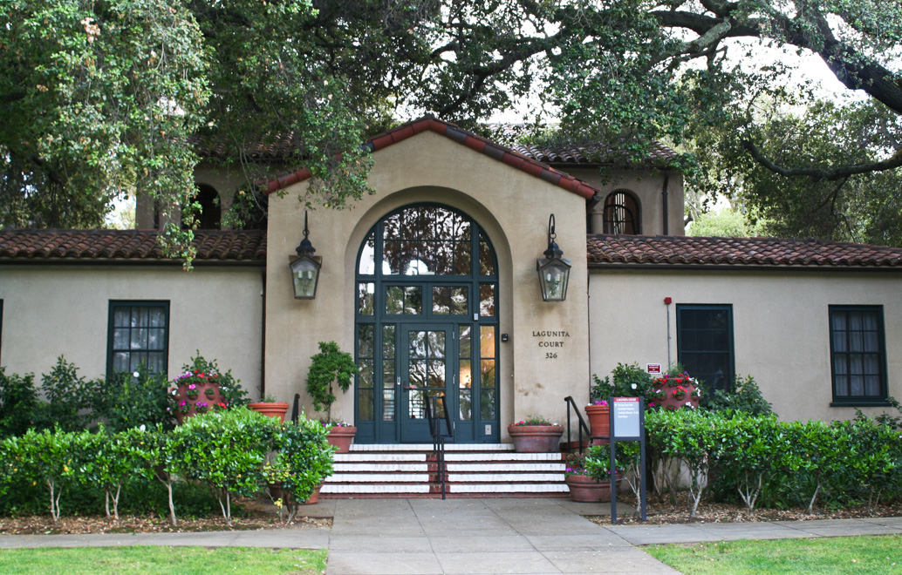
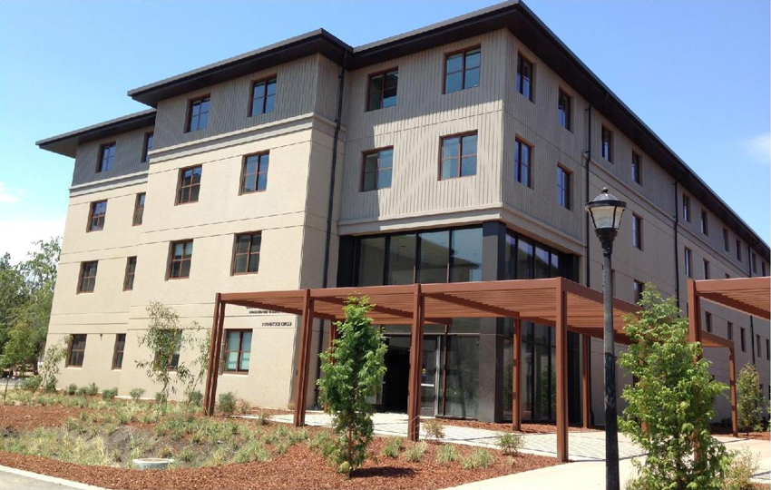
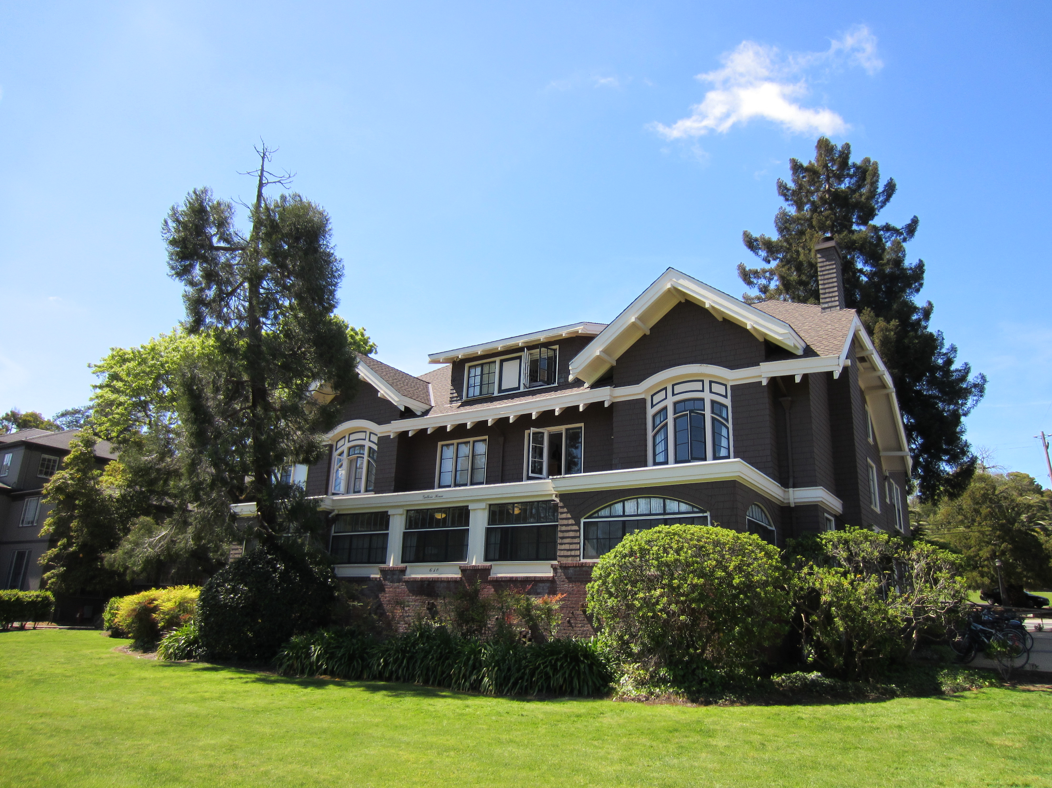
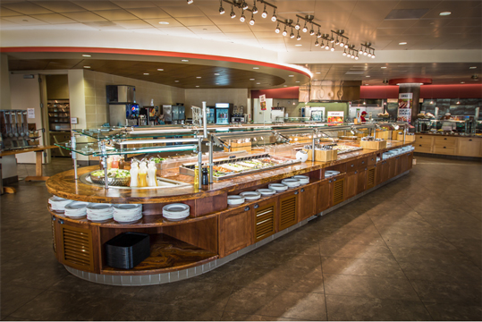
We build a sustainable future through collaborating with students, staff and academic departments to foster behavior change and drive efficiency through long term investment in our operations.
Stanford R&DE Student Housing Innovation in Green Cleaning
1/3
of campus
319
buildings
525
leased spaces
7.5m
gross square feet
15k
residents
8
Dining Halls
3.5m
meals served annually

Slide 3
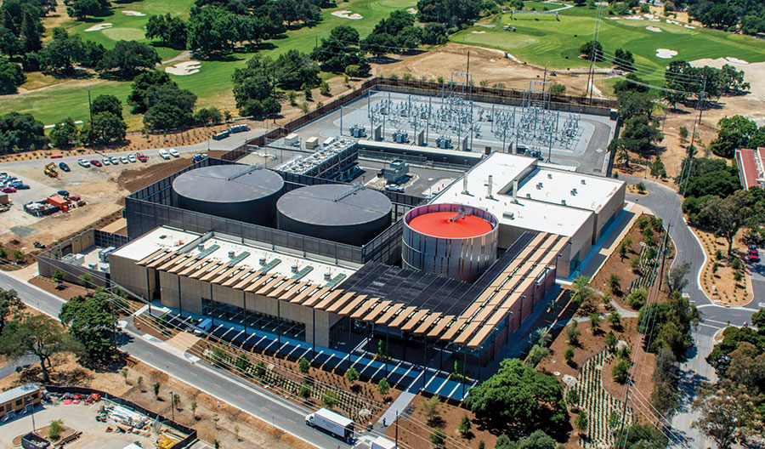
Stanford’s High Level Goals
2021
100% Renewable Electricity
2025
80% Carbon Free
2022 R&DE Goal
10% Reduction in Energy and Water Usage from 2017 Levels
2030
Zero Waste Campus
2025 R&DE Goal
100% Ozone Based Cleaning
*except for degreasing and oven cleaning
Stanford Central Energy Facility
Opened in 2015 reducing greenhouse gas emissions for the university by 64% and potable water by 18%.

Slide 4



Transforming The Way We Clean
Stanford R&DE Student Housing Innovation in Green Cleaning
Traditional Cleaning
Green Cleaning
Ozone Cleaning
Green cleaning refers to using cleaning methods and products with environmentally friendly ingredients and procedures which are designed to preserve human health and environmental quality. Green cleaning techniques and products avoid the use of products which contain toxic chemicals, some of which emit volatile organic compounds causing respiratory, dermatological and other conditions.

Slide 5
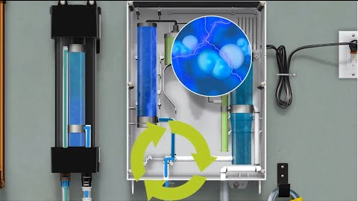
Transforming The Way We Clean
Stanford R&DE Student Housing Innovation in Green Cleaning
What is Ozone Cleaning? (Engineered Water)
The cleaning system transforms ordinary tap water into a great natural cleaner by infusing it with ozone - 4,500 volts of electricity add an extra oxygen molecule to O2, creating O3. This O3 is then infused into cold tap water to create ozone able to clean up to 24hrs.
Ozone is created naturally when sunlight adds an extra oxygen atom to some of the O2 molecules in the air.
Tersano TM

Slide 6
Transforming The Way We Clean
Stanford R&DE Student Housing Innovation in Green Cleaning
Ozone Cleaning
It converts safely back to tap water and oxygen.
Eliminates germs, odors, stains, mold, and mildew.
Quickly kills viruses and bacteria.
More powerful and faster acting than bleach.
Safe and effective with no toxins, carcinogens, or chemical residue.
Supports our zero waste goal. Reduces plastic pollution - and more.
Eliminates hazardous chemical disposal and regulatory compliance.
Eliminates chemical ordering, inventory, and distribution needs.
PPE nice, but not required.
“No” smell.
Reduces chemical inventory, training needs and risk.

Slide 7
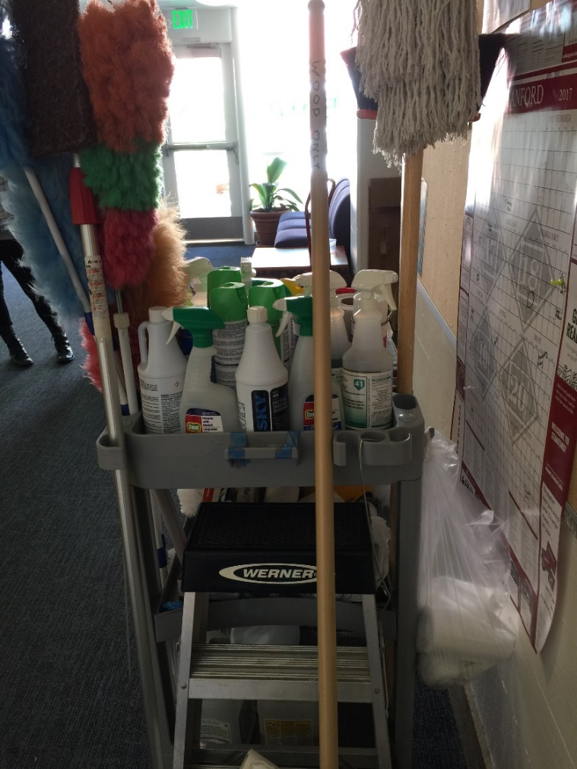
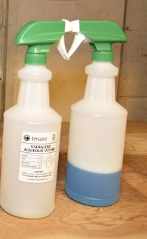
Transforming The Way We Clean
Traditional cleaning cart with over 30 chemicals inventoried to only 2 solutions.

Slide 8
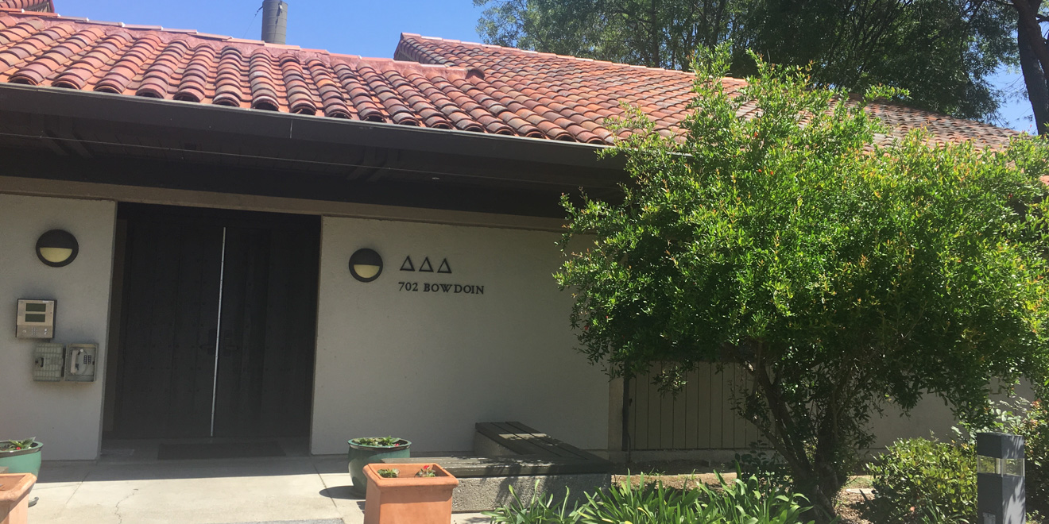
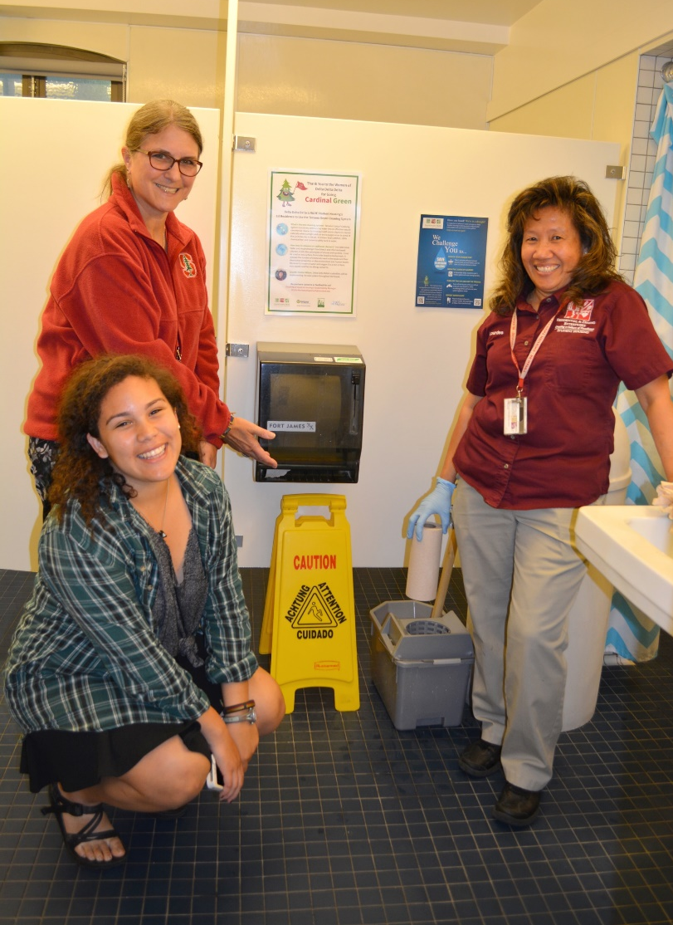
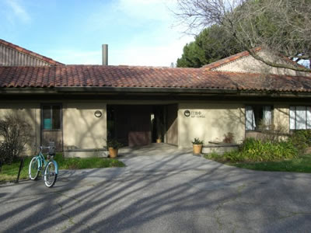
Transforming The Way We Clean
Delta Delta Delta
Ozone Cleaning
vs
Pi Beta Phi
Traditional Cleaning

Slide 9
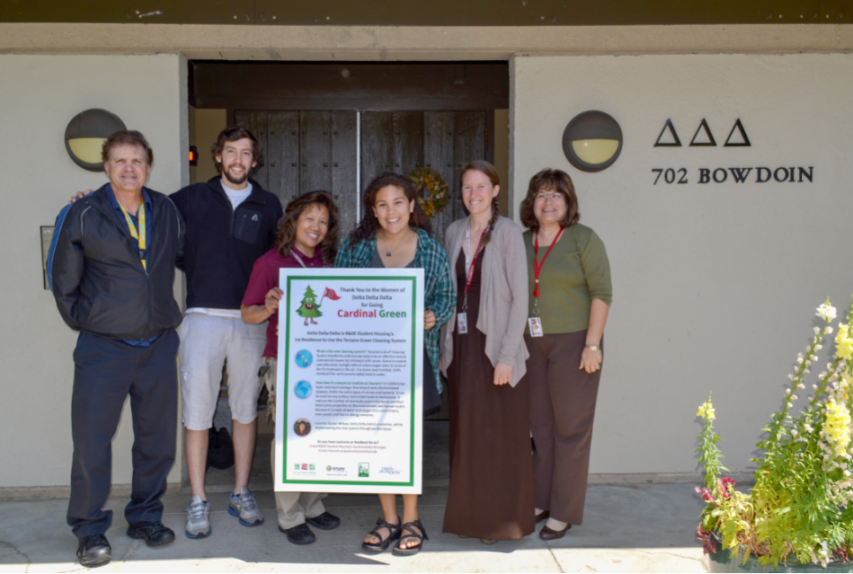
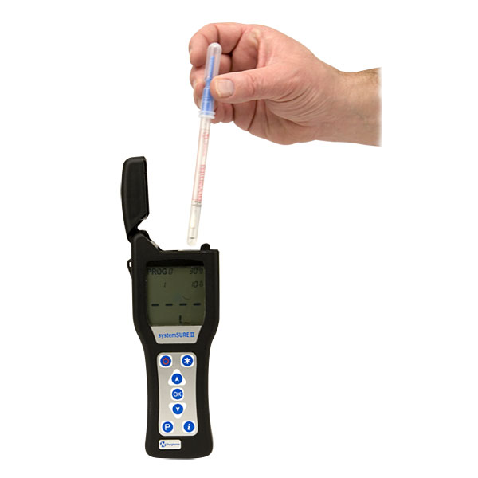
Transforming The Way We Clean
Pre and post occupant surveys revealed students felt their residence was “just as clean as it was with the old chemicals”.
Positive custodian feedback and satisfaction.
Bacteria testing proved it was just as good + kept surfaces cleaner longer.
Delta Delta Delta
Ozone Cleaning
vs
Pi Beta Phi
Traditional Cleaning

Slide 10
Transforming The Way We Clean
Stanford R&DE Student Housing Innovation in Green Cleaning
2.5-5.5
Payback Period
This only included chemical savings, no employee health or environmental savings, or the cost of receiving and distributing chemicals across our system.
This did not include electrical or plumbing upgrades needed for custodial closets. Conveniency is important to us.
-
+

Slide 11
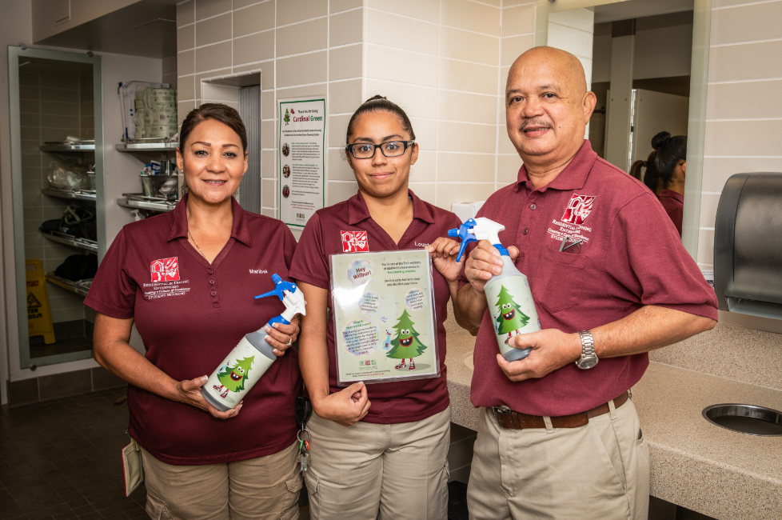
Transforming The Way We Clean
Stanford R&DE Student Housing Innovation in Green Cleaning
+4000 gal
annual avoided chemical purchase and disposal
70
buildings
3m
gross square feet
8,800
residents benefiting
+85 FTE
custodians benefiting

Slide 12
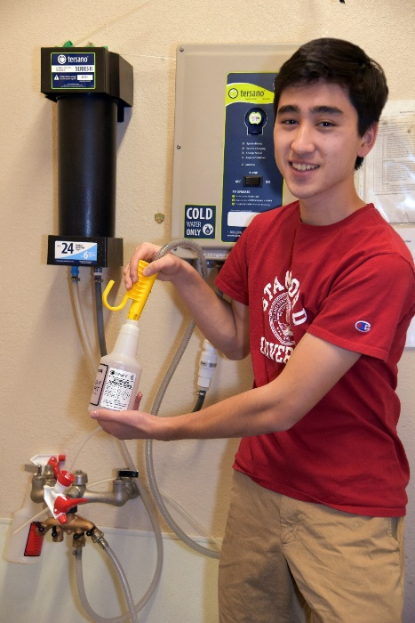
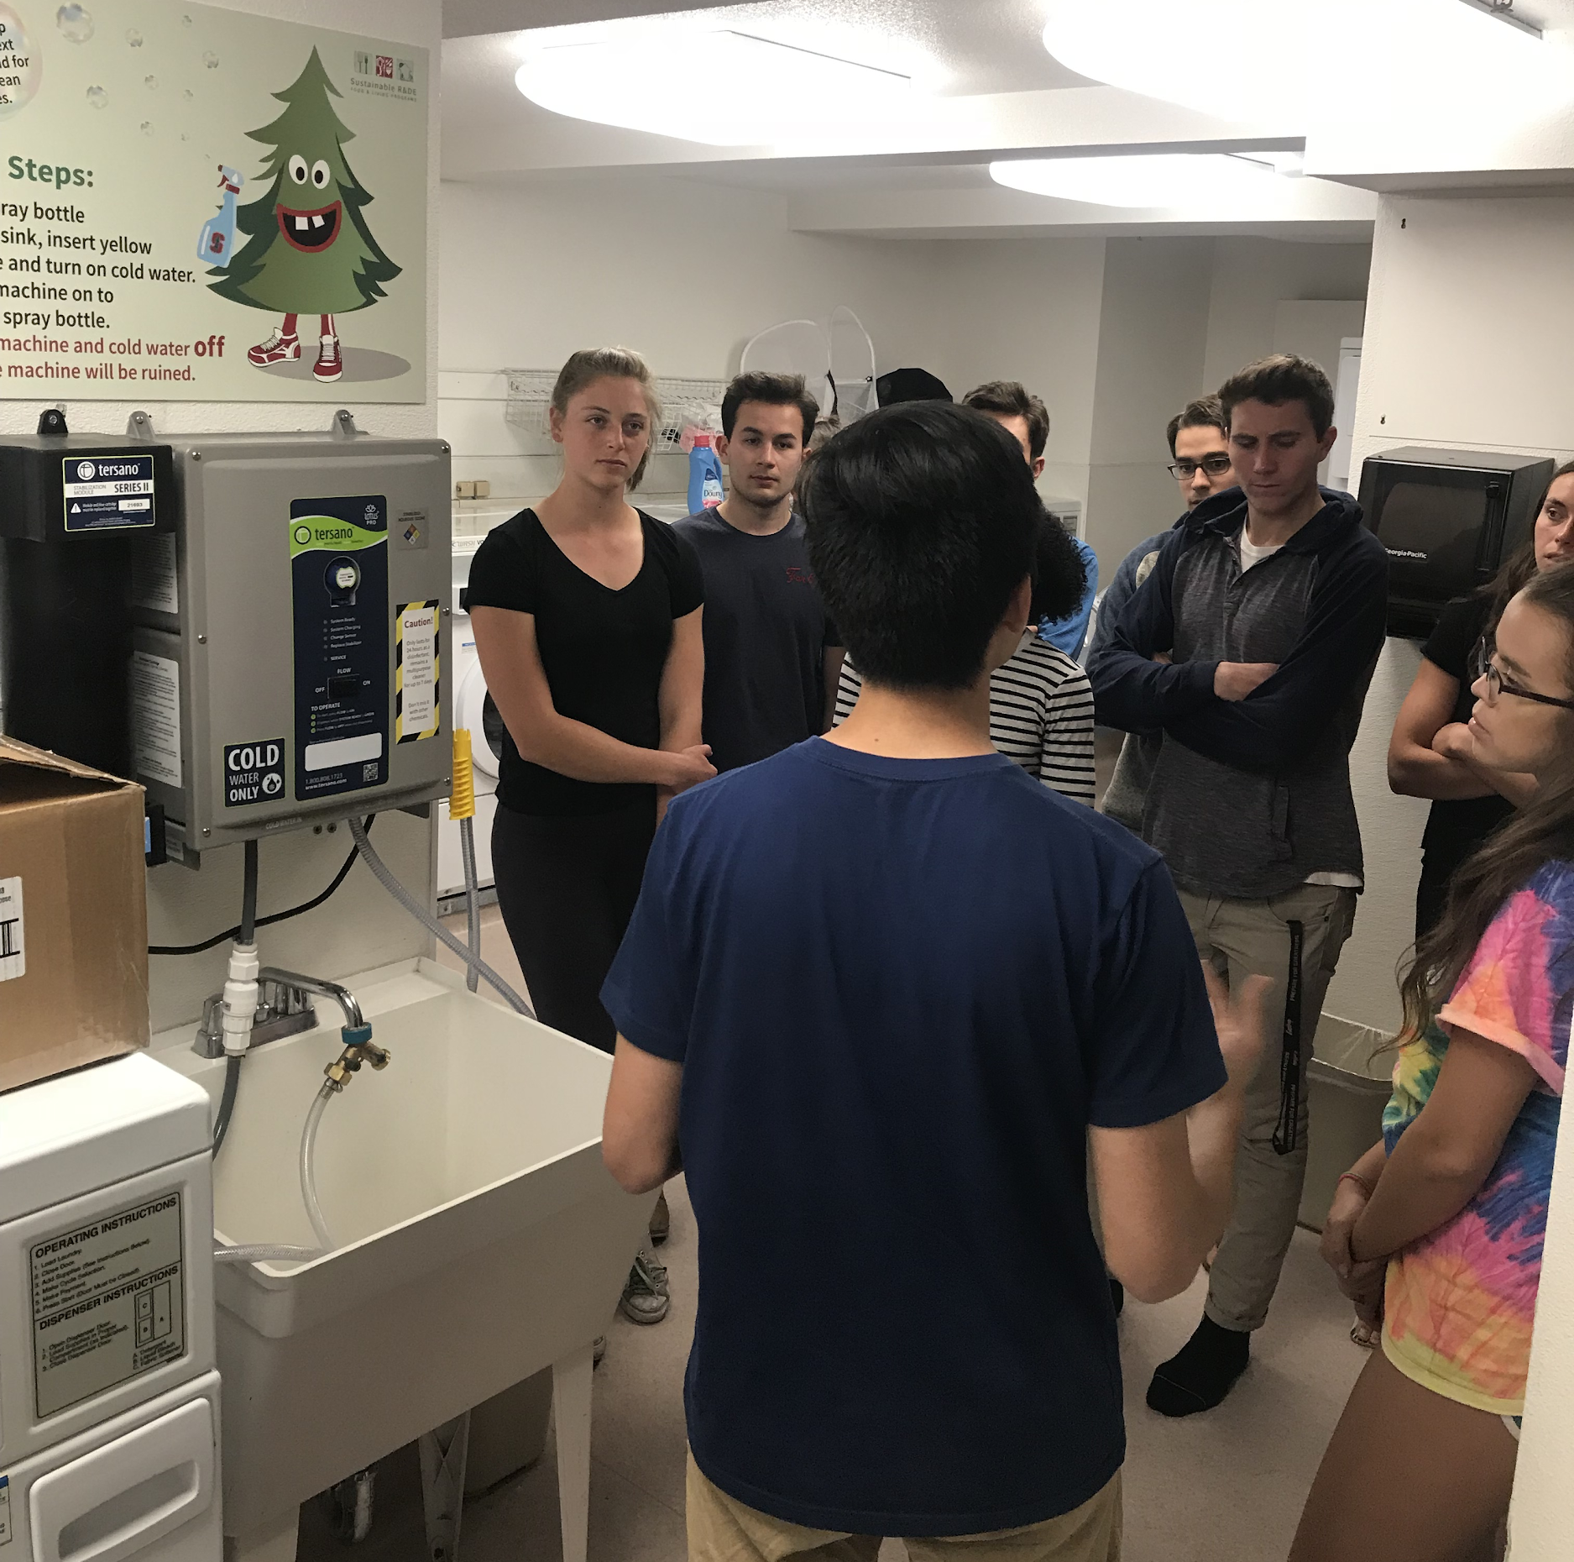
Transforming The Way We Clean
Stanford R&DE Student Housing Innovation in Green Cleaning
50% of Stanford students live in apartments they clean themselves. A student access pilot introduced 289 students to the new system, that could save them over $10,000 a year in chemical purchases and laundry detergent.

Slide 13
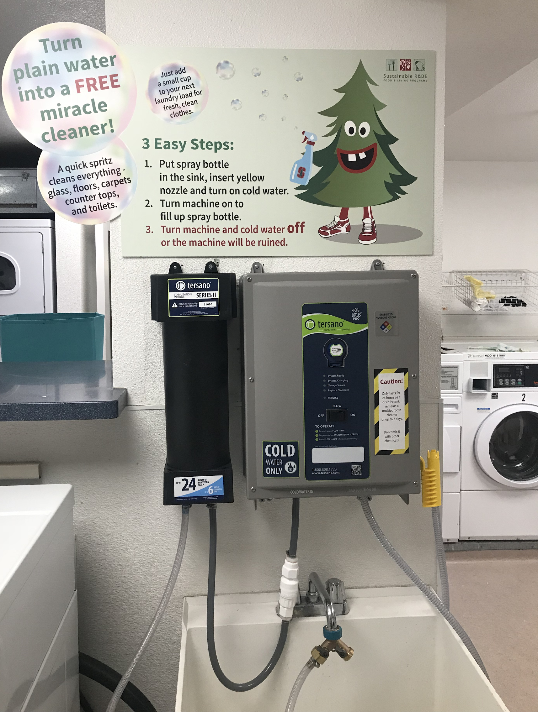
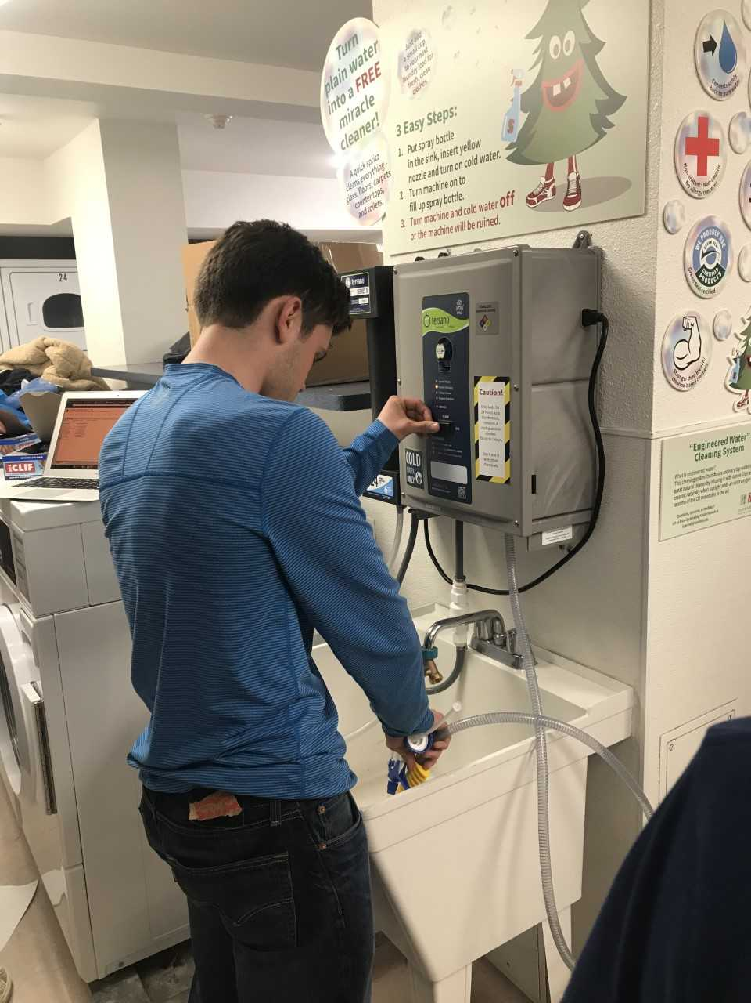
Transforming The Way We Clean
Stanford R&DE Student Housing Innovation in Green Cleaning
Stanford R&DE Student Housing Innovation in Green Cleaning
Crooms to clean their apartments.

Slide 14
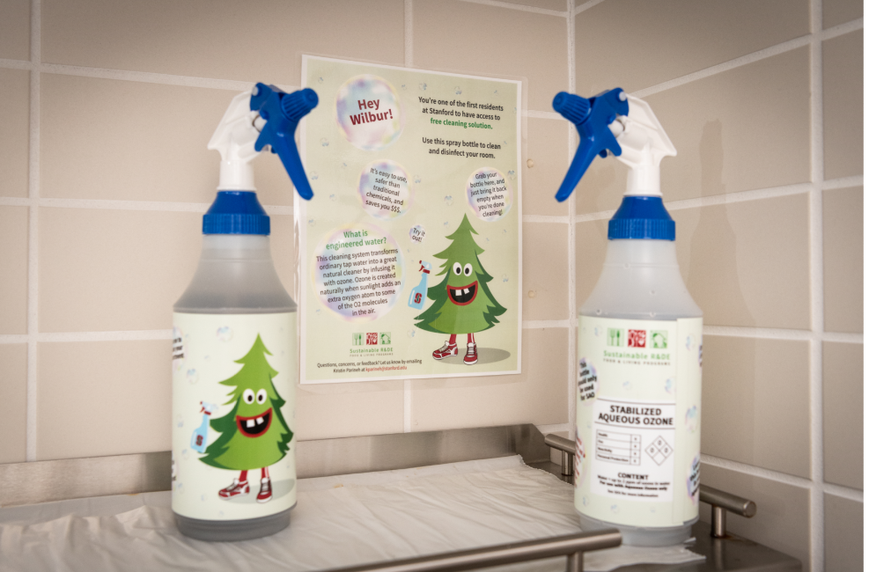
Transforming The Way We Clean
Stanford R&DE Student Housing Innovation in Green Cleaning
Stanford R&DE Student Housing Innovation in Green Cleaning

Slide 15

Transforming The Way We Clean
Stanford R&DE Student Housing Innovation in Green Cleaning
Coming in 2020 2,400 grad students will dispense engineered water from their laundry rooms to clean their apartments.

Slide 16

Transforming The Way We Clean
Stanford R&DE Student Housing Innovation in Green Cleaning
Stanford R&DE Student Housing Innovation in Green Cleaning
Creating a New Cleaning Culture

Slide 17
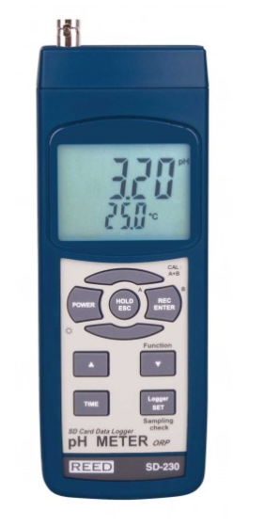
Transforming The Way We Clean
Stanford R&DE Student Housing Innovation in Green Cleaning
Stanford R&DE Student Housing Innovation in Green Cleaning
Creating a New Cleaning Culture
Prove it works… over and over again.
Sustainability staff measure bacteria levels using an ATP meter pre and post the new cleaning solution to prove its effectiveness with staff, building managers and students. The green cleaning solution has no harmful odor, looks like water and does not bubble like traditional cleaners so bacteria testing is helpful with changing culture.
ORP Meter
ATP Meter

Slide 18
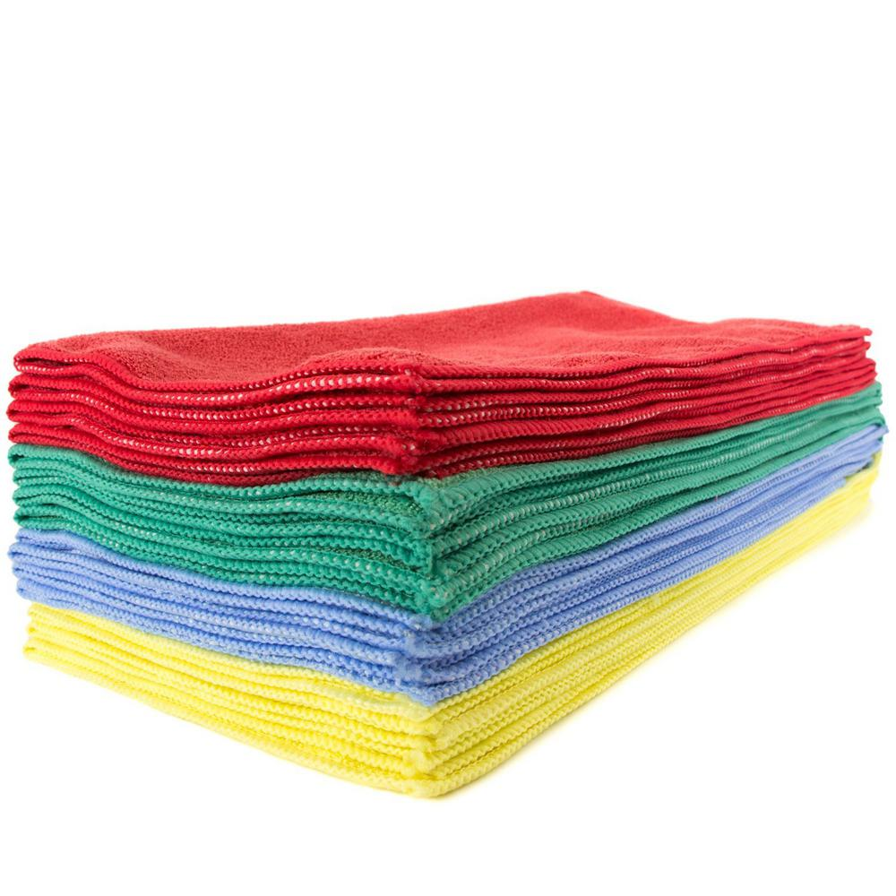
Transforming The Way We Clean
Stanford R&DE Student Housing Innovation in Green Cleaning
Stanford R&DE Student Housing Innovation in Green Cleaning
Creating a New Cleaning Culture
Invest in new custodial equipment: microfiber mops and towels, new mop buckets and spray bottles.

Slide 19
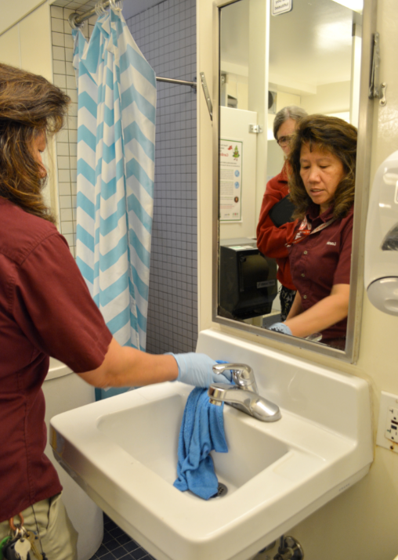
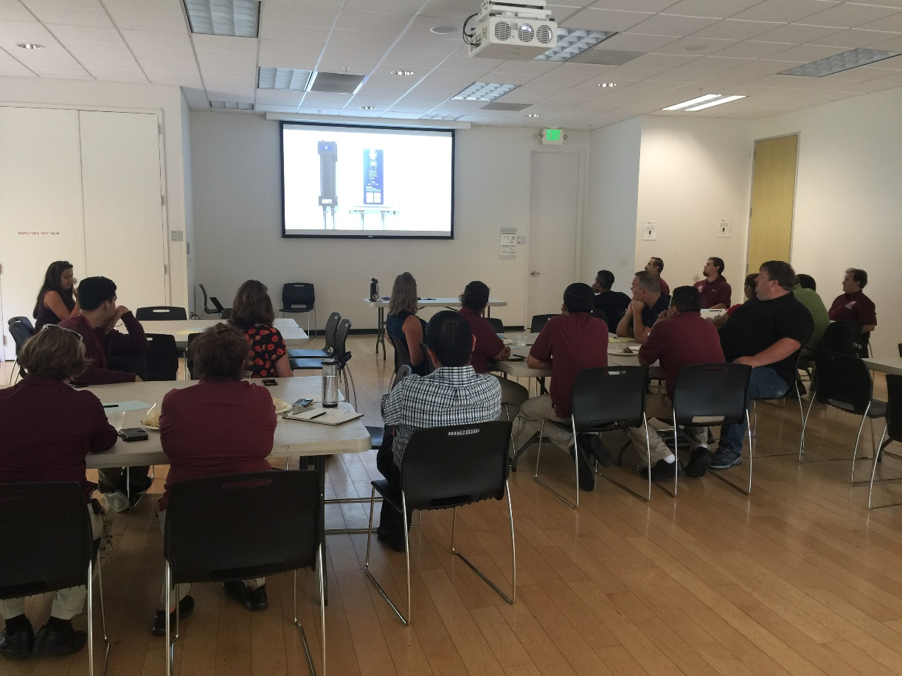
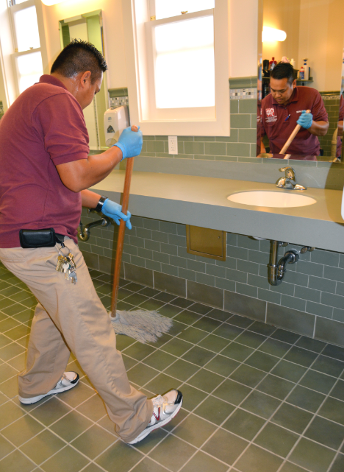
Transforming The Way We Clean
Stanford R&DE Student Housing Innovation in Green Cleaning
Stanford R&DE Student Housing Innovation in Green Cleaning
Stanford R&DE Student Housing Innovation in Green Cleaning
Education and Collaboration
Creating a New Cleaning Culture
+
Ozone cleaning user group.
Stainless Steel and Mirrors.
No smell.
-
Whitening.
Clear up confusion.

Slide 20
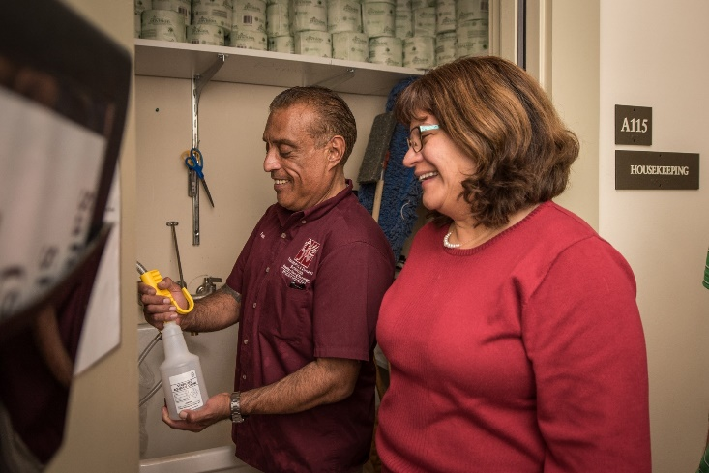
Transforming The Way We Clean
Stanford R&DE Student Housing Innovation in Green Cleaning
Stanford R&DE Student Housing Innovation in Green Cleaning
Stanford R&DE Student Housing Innovation in Green Cleaning
Stanford R&DE Student Housing Innovation in Green Cleaning
Creating a New Cleaning Culture
Education and Collaboration
“It is ok it’s not white. It does not mean its not clean.”
(We changed our grout standard.)
"Sustainability is a core value we strive to integrate in to every level of our operation. Adopting engineered water as our green cleaning standard just made common sense.... it is great for our custodians health, it reduces our operating expenses and impact on the environment all while keeping our residences just as clean and safe for students.“
– Imogen Hinds Senior Director of Stanford R&DE Student Housing Operations

Slide 21

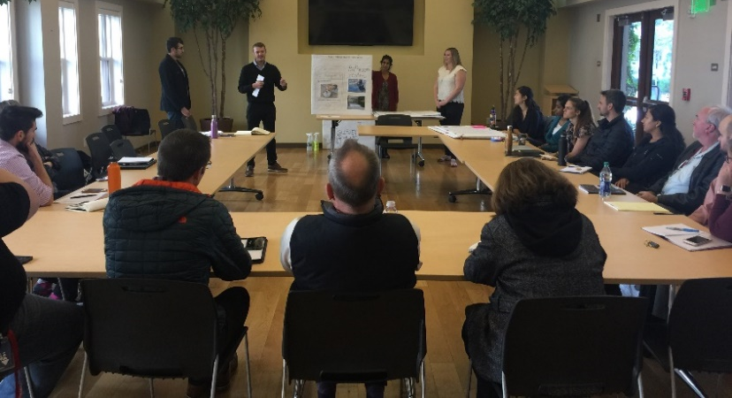
Stanford R&DE Student Housing Innovation in Green Cleaning
Transforming The Way We Clean
Academic Partnership
Creating a New Cleaning Culture
Academic partnerships led to new insight on program adoption amongst custodians and student awareness of the new system.

Slide 22
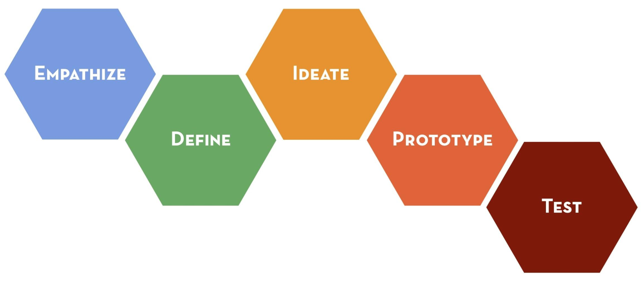
Stanford R&DE Student Housing Innovation in Green Cleaning
Transforming The Way We Clean
Academic Partnership
Creating a New Cleaning Culture

Slide 23
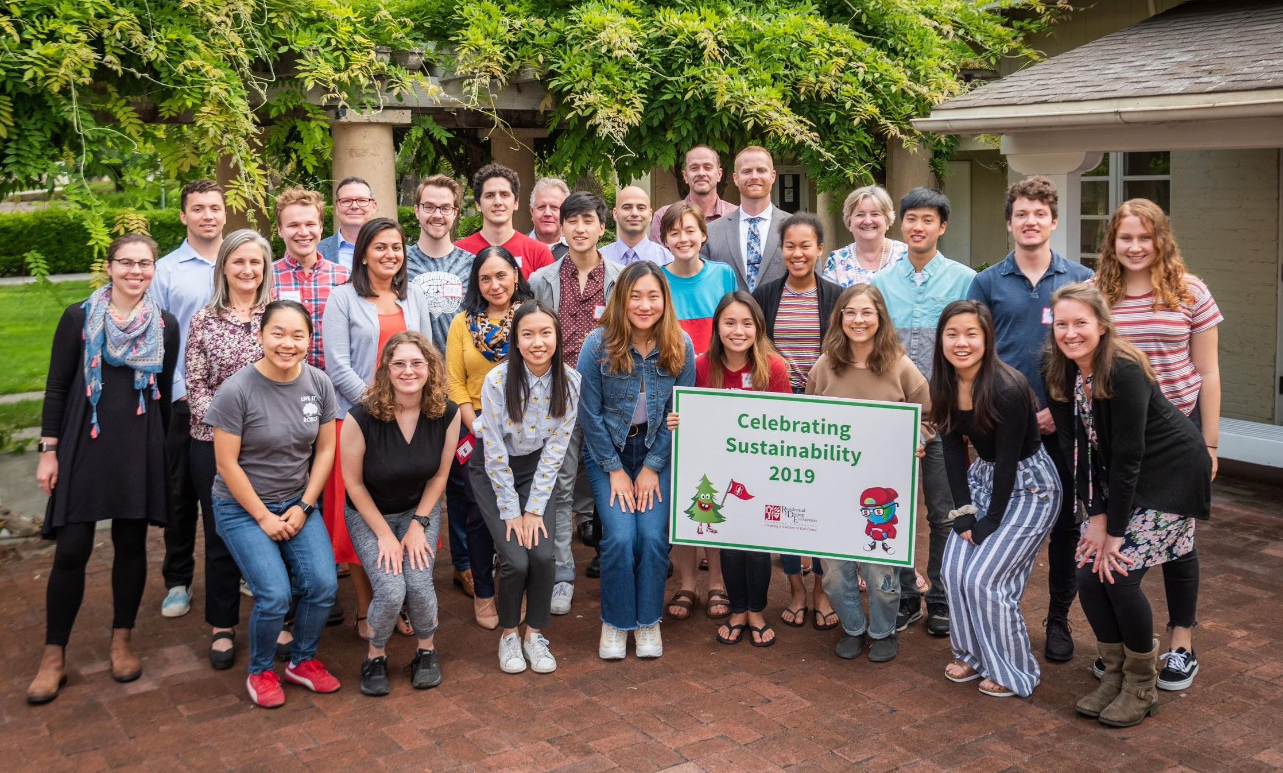
Stanford R&DE Student Housing Innovation in Green Cleaning
Transforming The Way We Clean
Academic Partnership
Creating a New Cleaning Culture

Slide 24
Stanford R&DE Student Housing Innovation in Green Cleaning
Transforming The Way We Clean
Academic Partnership
Creating a New Cleaning Culture
“It’s just water.”

Slide 25
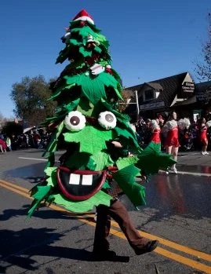
Stanford R&DE Student Housing Innovation in Green Cleaning
Transforming The Way We Clean
Academic Partnership
Creating a New Cleaning Culture

Slide 26
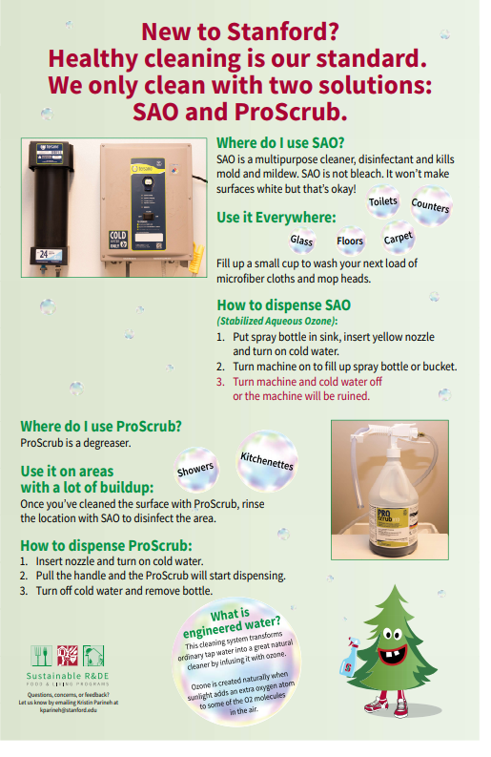
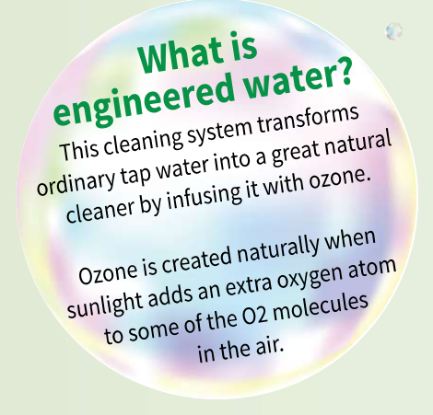

Slide 27
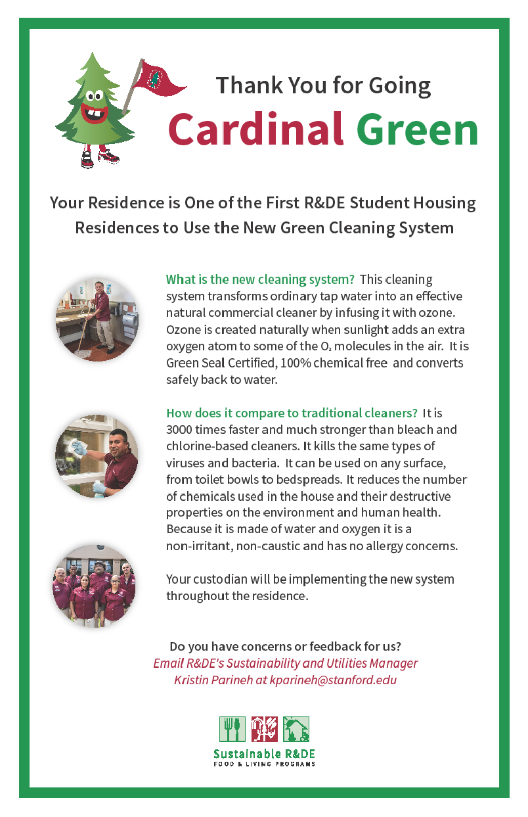
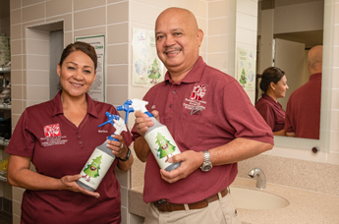

Slide 28

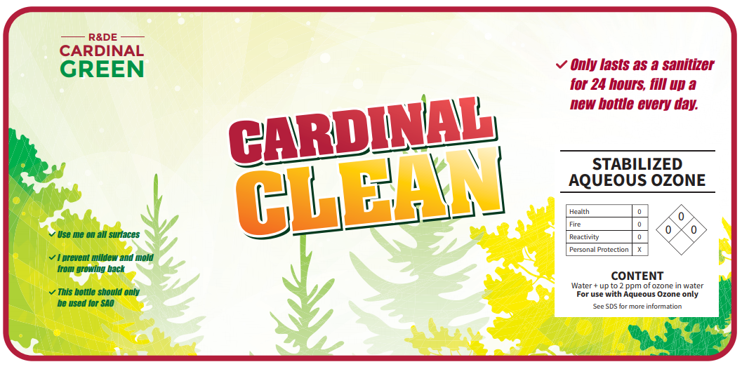

Slide 29
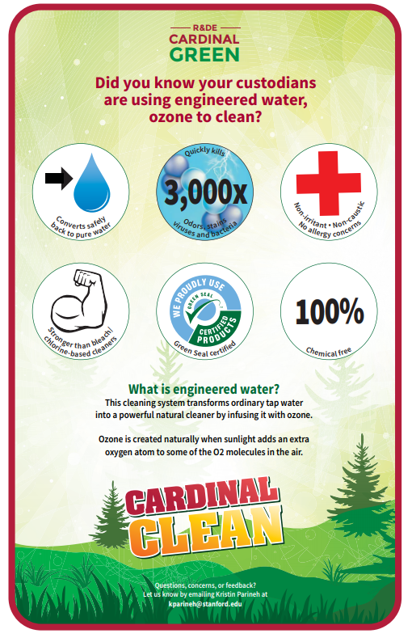
Transforming The Way We Clean
Stanford R&DE Student Housing Innovation in Green Cleaning

Slide 30
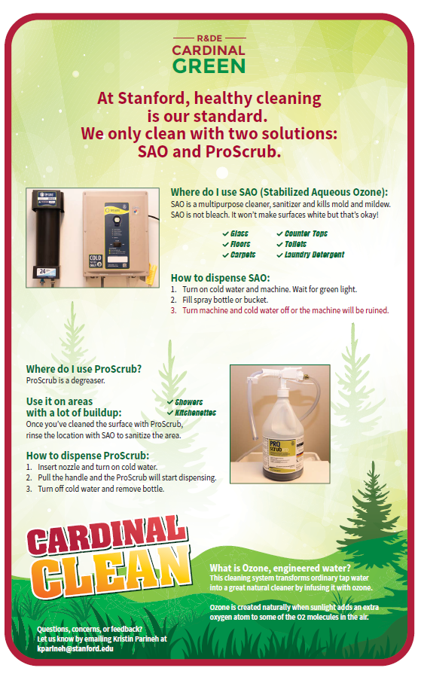
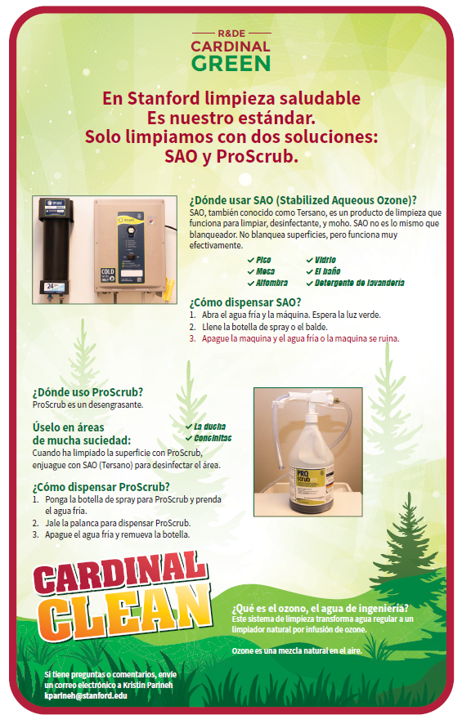

Slide 31
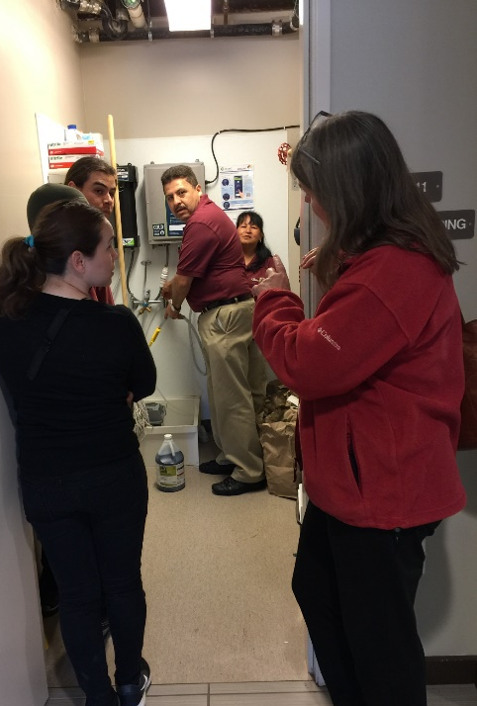
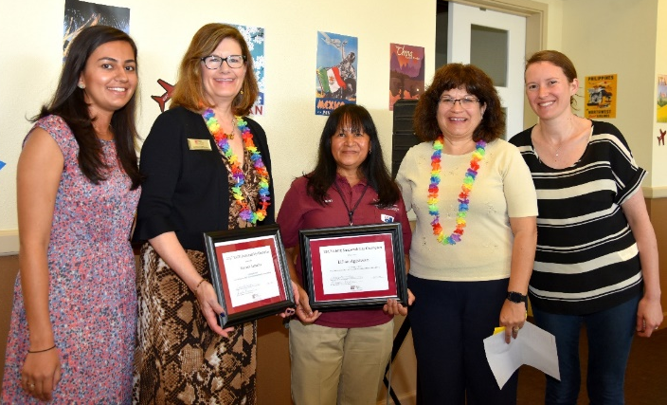
Transforming The Way We Clean
Stanford R&DE Student Housing Innovation in Green Cleaning
Stanford R&DE Student Housing Innovation in Green Cleaning
Creating a New Cleaning Culture
Recognize champions - Awards, Dining Lunches, Letting them Lead. When you are no longer needed you have succeeded in culture change.

Slide 32

Stanford R&DE Student Housing Innovation in Green Cleaning
Questions?
Kristin Parineh
Sustainability and Utilities Manager
kparineh@stanford.edu

